Slide 1
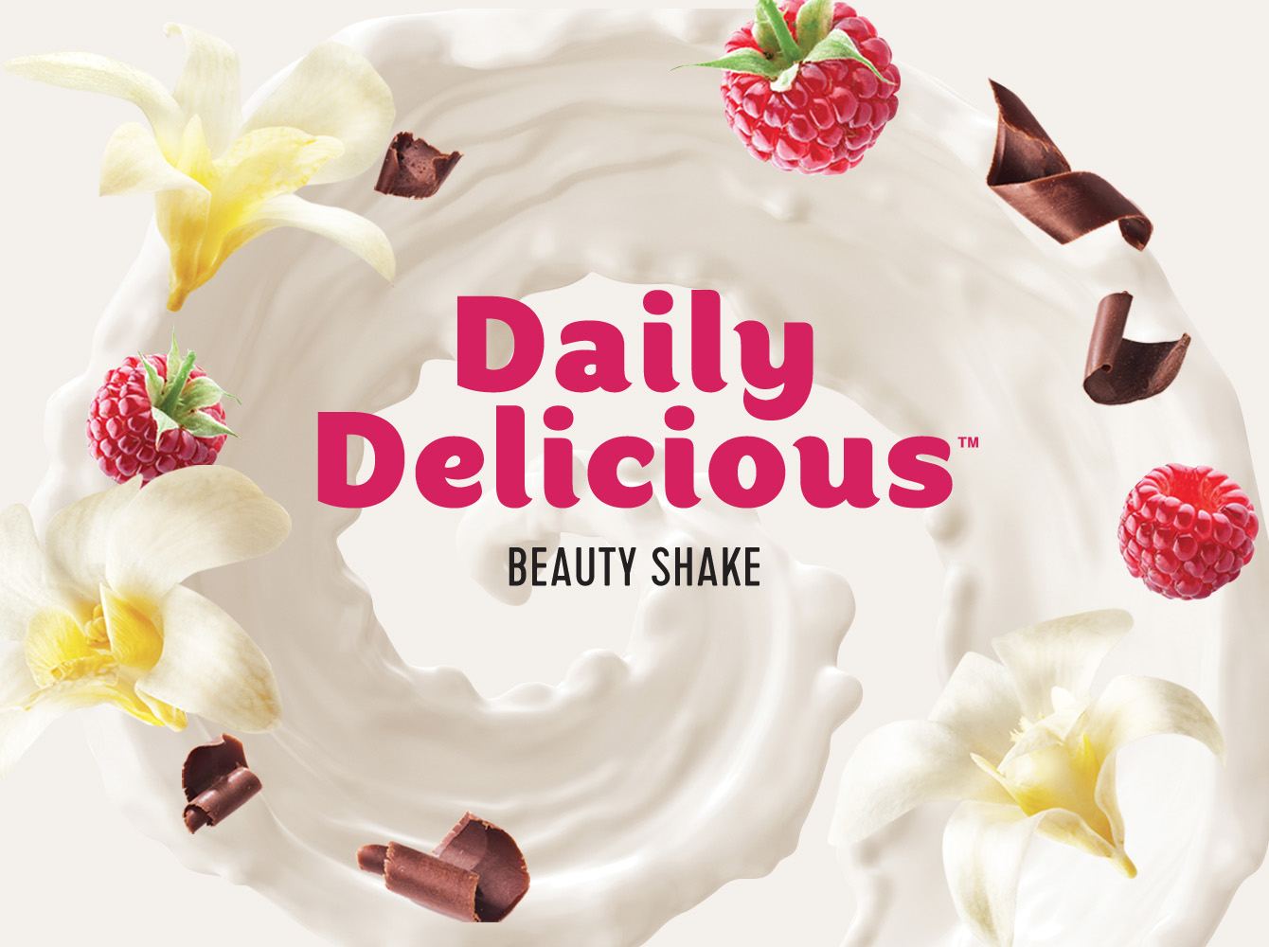
PROTEIN SHAKES
FOR HEALTH AND BEAUTY

Slide 2
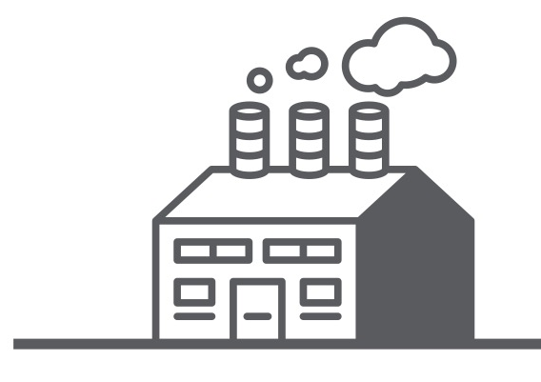

World around us
70 %
30 %
Notes:
Our modern lifestyles are all too often lacking in what we need for increased vigor and life expectancy. Why is that?
• Negative environmental factors. The atmosphere continues to accumulate harmful emissions from transportation, energy production and industry, and our bodies are incessantly bombarded by electromagnetic radiation from all of our household gadgets, cell phones and computer hardware.
• The pace of our lives has quickened. We cut short our time for sleep and true recreation.
• People in today’s society are in a constant state of stress, from commute to daily grind. The mass media are also often the bearers of bad news.
• Harmful addictions. One cigarette burns off 25-30 mg of Vitamin C.
• We are less physically active. Our lifestyles have become more sedentary.
Our diets have changed. We never have the time to prepare food that is healthy and tasty. We scarf down our food with dry mouths. What kinds of things do we nourish ourselves with today? Our foods are dense (hamburgers, pasta, breads and pastries) and we consider that abundance is the key to healthy eating. But this is a grave misconception, as the quality of the food does not meet our bodies’ needs for nutrients.
Many of the foods we consume contain preservatives, thickening agents, artificial colors and flavor enhancers that serve only to improve their superficial appearance or taste while in no way doing the same for their quality.
While we eat fruits and vegetables every day, we still fail to reach the amounts of vitamins and minerals we truly require, because the soils we farm today are, like the atmosphere, polluted and depleted. Even more nutrients are lost during transport.
On top of that, store-bought “fresh” vegetables, fruits and herbs are often treated to increase their shelf life, but that can lead to a significant reduction in their nutritional value.
We often use low-fiber, highly refined ingredients in our kitchens. Doesn’t everyone know that nutrients are found in their highest concentrations in peels, skins, bran and germ, everything we so often treat as food waste.
Moreover, most plant-based nutrients are lost when high-temperature cooking methods are used.
As a result of the use of hormones and antibiotics in the livestock and poultry farming industries, and growth agents in crop farming, we end up with groceries that are depleted of nutrients, and moreover, which cause harm to health.
As a result, an abundance of carbohydrates, fats, calories, and a deficit in fiber, protein and nearly all vitamins and many minerals.
Scientific research confirms that even in highly developed countries, the majority of people who eat vegetables and fruit several times a day still suffer from a lack of vitamins and minerals. Residents of the U.S.A., Germany, France and the U.K. only consume 30% of the nutrients their bodies require on a daily basis.

Slide 3

HEALTHY DIET
+
dietary supplements
+
meal replacements
Notes:
What can be done about the fact that our food does not provide us with all of the life-giving vitamins and minerals our bodies need?
For example, let’s look at how Japan has managed to change the situation. The Land of the Rising sun is a perfect example of the local attentive attitude toward maintaining their fellow citizens’ health. Did you know that there are over 50,000 centenarians living in Japan?
At first glance, Japanese medicine appears very strange to us. It is not uncommon for a doctor to prescribe a daily 40-minute walk around the park. Japanese are very obedient, and will always strictly follow all instructions.
So what is the secret behind the greater longevity enjoyed by the Japanese?
► First of all, they maintain a stable and complete diet and sufficient physical activity.
► Secondly, they undergo regular medical check-ups.
► Thirdly, the country’s national health insurance program, which has succeed in raising the quality of life and has propelled Japan to its record health and longevity indicators.
The decision was made 50 years ago to adjust dietary recommendations with the help of biologically active supplements. Currently, 90% of Japan’s residents take nutritional supplements on a daily basis. Even job application forms contain questions about which supplements the person is taking. It helps to gain a better picture of how much responsibility the applicant is taking for their health and how diligent the person is overall. Japanese companies always value healthy staff that are full of energy and share a like mind with their team.
As a result of this approach to supplements, Japanese tend to look younger than their age and remain physically active.
Dietary supplementation and meal replacement prevalence around the world:
Japan – 90% of the population
U.S.A. – 70% of the population
Europe – 50% of the population
In Russia, only around 3% of the population take BAS, and that number is 3-8% in other CIS countries.

Slide 4

Demands of modern society
Notes:
Our daily routine is split between not enough time and constantly busy.
Don’t you agree?
As a result, we become much more picky when it comes to our food!
In order for it to meet the demands of modern society, food must be:
Quick: it has to allow us to save time, both during preparation and when we eat it
Nutritious
Healthy
Safe
Need we mention the taste?
Getting all of those things from one meal seems like a pipe dream.
Practice, along with the food cultures now prevalent in Europe, Japan and the U.S.A., show that combining all of these features in your diet is indeed feasible.
Let’s find out how!

Slide 5
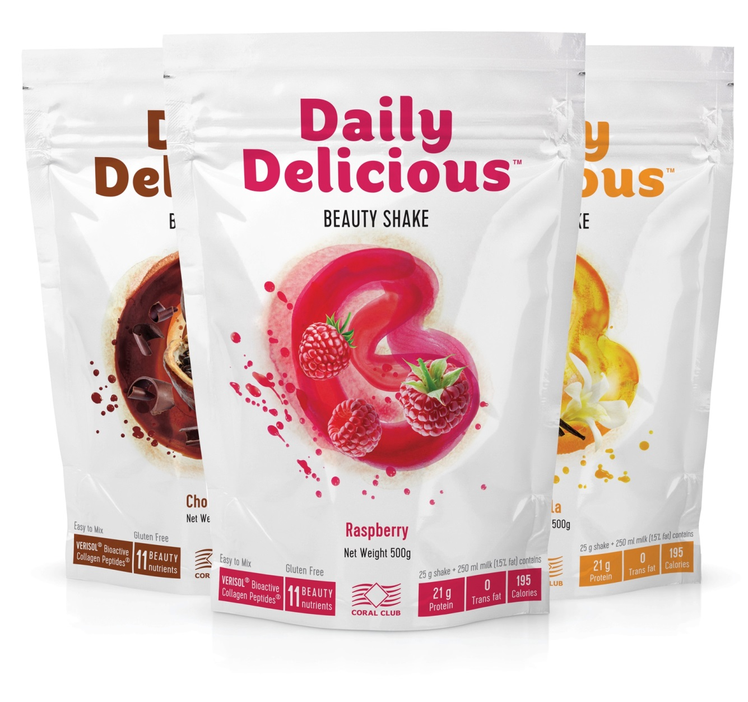
Daily Delicious Beauty shake
Notes:
The Daily Delicious line of nutritious health products also includes Beauty Shake – beautiful never tasted so good.
It is no secret that things that taste good are usually not good for you and those things that are healthy are often lacking in good flavor.
After a year and a half of development, a new product was created that meets the most stringent criteria of taste and nutritional value.
Not only is our Daily Delicious product line healthy, it is truly delicious! This balanced source of animal and plant protein in combination with collagen and a vitamin and mineral complex support vitality and physical activity, strengthening you with the energy you need every day.
The shakes are free of GMOs and ingredients derived from them.

Slide 6

Daily Delicious Beauty shake
Healthy
Delicious
Convenient
Affordable
Notes:
What makes our product unique is its ingredient list:
1. A balanced protein formula made of three of the most nutritious forms of protein: milk protein, whey protein concentrate and soy protein isolate.
2. Vitamins and minerals selected to care for your skin, hair and nails.
3. The super-ingredient peptide collagen, a veritable elixir of youth. Protein shakes containing collagen are highly popular in Japan.
4. Natural flavor! Three of the most delicious and popular flavors ever, whether in combination or individually.
The product’s high quality comes from its components:
High-quality, premium-priced whey protein
Only natural vanilla, raspberry and chocolate flavors
The natural sweetener erythritol

Slide 7

HEALTHY
21 g of high-quality protein in every shake
11 beauty-enhancing nutrients
Super-ingredient – collagen Verisol
Notes:
What makes our product unique is its ingredient list:
1. A balanced protein formula made of three of the most nutritious forms of protein: milk protein, whey protein concentrate and soy protein isolate.
2. Vitamins and minerals selected to care for your skin, hair and nails.
3. The super-ingredient peptide collagen, a veritable elixir of youth. Protein shakes containing collagen are highly popular in Japan.
4. Natural flavor! Three of the most delicious and popular flavors ever, whether in combination or individually.
The product’s high quality comes from its components:
High-quality, premium-priced whey protein
Only natural vanilla, raspberry and chocolate flavors
The natural sweetener erythritol

Slide 8
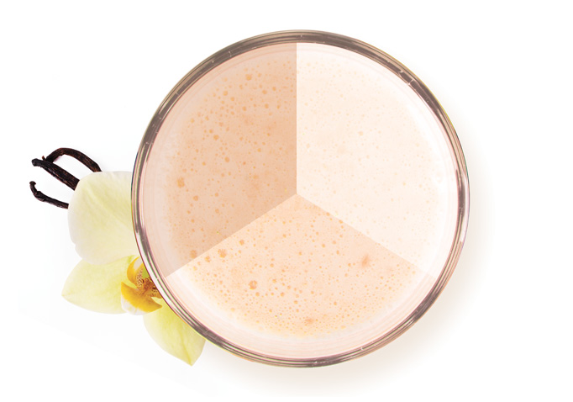
A Balanced Protein Formula
MILK
SOY
Long-lasting feeling of fullness
Rich in nutrients
WHEY
Reduces hunger quickly
Notes:
Protein based
The base for Daily Delicious Beauty Shake is made of a balanced formula composed of 3 of the most effective sources of protein: milk protein, whey protein concentrate and soy protein isolate.
What do proteins do for our body? Here are some of their main functions:
Practically all tissues use proteins as their primary construction materials. They are part of the blood, muscles, hair, nails, skin and internal organs. Protein-rich foods are a top choice of athletes, because they make it possible to quickly and effectively build muscle mass.
Proteins help deliver nutrients and other health-supporting compounds to the cells. Without them, this transportation would be impossible. Protein molecules play a vital role in strengthening the immune system and building new immune cells.
Proteins are among some of the most important enzymes that speed up a number of important biochemical reactions that occur in the body. Without enough protein, the metabolism slows down, quickly leading to weight gain. Because of this, protein products are an important part of many weight-loss diets.
Proteins slow down the digestion of carbohydrates. This reduces the total glycemic index of the food being eaten, and makes it possible to maintain sufficient blood sugar levels without significant jumps in insulin production. This makes it far easier to overcome feelings of hunger and control one’s weight.
Milk protein - an essential element of diet.
Cells and tissues of the body are formed only from dietary protein. Proteins contribute to key body functions and it is very important continuously add to your diet foods that contain protein. Especially immediately after a full night of sleep or a tiring workout, the body has little to no protein available to rebuild tissue, we need to ensure that the body has an adequate supply.
The protein used in Daily Delicious is prepared from fresh milk and contains up to 93% pure protein. Of all the animal protein milk protein is considered one of the best along with the egg white. First of all, milk protein has a high nutritional value. It is much more readily absorbed by the body than meat protein or even fish protein.
Secondly, as opposed to proteins extracted from plants, milk protein contains all of the essential amino acids.
Whey Protein Concentrate - another useful food product which is made from whey.
Whey protein concentrate is highly nutritious and contains up to 81% pure protein. It is unique in how easy it is to digest and how quickly the amino acids are absorbed by muscle cells.
So called "bricks" of the whey protein help to restore our tissue after injuries and sprains. After surgeries our bodies especially need a good portion of the easily digestible protein, because the new muscle fibers would not be able to form if the body does not get enough amino acids.
Soy protein isolate is a food product that is not only rapidly absorbed, but contains up to 90% vegetable protein. The production process involves treating the soy isolate to remove all residual oils, carbohydrates, isoflavinoids and other substances, leaving you with pure soy protein.
Therefore, among all vegetable proteins, soy isolate is considered to be the most healthy one.
Nutritionists recommend soy isolate to people whose bodies have difficulty to digest casein protein or unable to tolerate lactose.
In addition, soy protein is preferred by those who are actively involved in sports and lead a healthy lifestyle. This product is also very useful to people who want to lose weight and is in search of a decent alternative to traditional products containing natural protein. Soy protein is perfect for vegetarians who can use it as a substitute for the heavy meat.
Soy isolate is rich in many essential and nonessential amino acids, it combines perfectly with milk protein. Together they help to qualitatively enrich the diet of older people and people with poor health, compensate for the deficiency of complete protein and improve overall health.

Slide 9

11
BEAUTIFYING NUTRIENTS
Notes:
The shake contains 11 nutrients (vitamins and minerals) of the finest quality, each of which is intended to provide daily care for your health and beauty. Their combined effect helps to keep your skin elastic and firm, your hair lustrous and your nails strong.

Slide 10
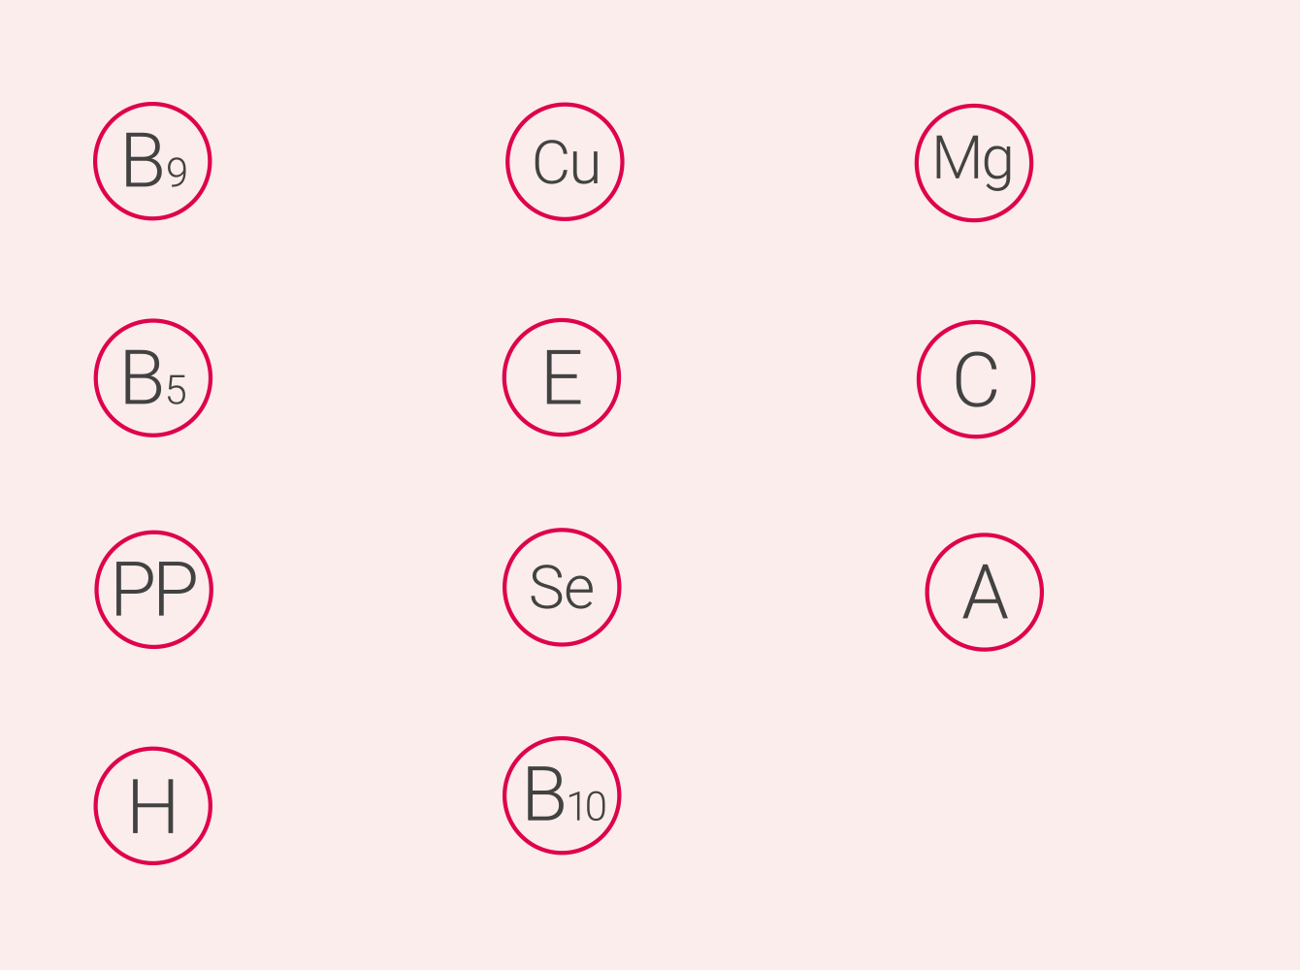
Folic acid
Copper
Magnesium
Pantothenic acid
Vitamin Е
Vitamin С
Niacin
Selenium
Vitamin А
Biotin
4-Aminobenzoic acid
Notes:
4-Aminobenzoic acid (В10)
Protects the skin from the effects of the sun
Normalizes melanin production in the skin
Prevents and reduces the appearance of moles and freckles
Vitamin А
Prevents the formation of stretch marks and acne
Nourishes the skin, evens facial skin tone
Vitamin С
Stimulates collagen production
Strengthens blood vessel walls
Increases skin elasticity
Niacin (РР)
Possesses a regenerating effect
Protects against dermatological conditions
Prevents hair loss
Vitamin E
Strong antioxidant
Participates in skin regeneration
Makes skin firm, yet elastic
Pantothenic acid (В5)
Strengthens the hair and nails
Slows down skin aging processes
Makes hair silky
Folic acid (В9)
Essential for healthy hair growth
Keeps skin looking healthy
Biotin (Н)
Helps hair retain moisture
Stops nails from splitting and chipping
Strengthens the inner skin layers
Magnesium (Mg)
Smoothes out wrinkles
Strengthens fingernails
Responsible for elastin production
Selenium (Se)
Slows down skin aging processes
Prevents dandruff
Copper (Cu)
Helps in the production of elastin
Protects from hair loss

Slide 11

Super-ingredient of youthfulness
Verisol
®
Notes:
Verisol peptide collagen was developed to improve the quality of life of people around the world. Many scientific studies have proven that it improves the functional state of joints and bones, and helps to normalize weight and slows down the aging of the skin.
The Verisol collagen combines beautifully with the other ingredients, is readily absorbed and taken up by the body.
Working from the inside out, the Verisol peptides directly hinder the breakdown of collagen in the skin, allowing the moisturizers to penetrate deeper, making it more supple and slowing down the wrinkle formation process.
Verisol Hydrolyzed Collagen is a highly effective form of collagen consisting of three peptides (amino acids): lysine, proline, and hydroxyproline. Its low molecular weight helps the collagen to start working quickly to reinforce your skin.
The amino acid lysine plays a special role in the production of collagen, the most important protein in the formation of muscular connective tissues, cartilage, ligaments and skin, aids in the regrowth of muscle tissues, and is required from the absorption of other important amino acids. Lysine is highly important for the normal functioning of the heart muscle, which is also important for athletes and people leading an active lifestyle.
When the body does not get enough lysine, the whole system of protein metabolism is thrown off balance. For instance, among athletes, especially long-distance runners, lysine deficiency can lead to chronic tendinitis and muscle fatigue.
Collagen peptides are a universal source of protein. They act in tandem with the other ingredients and are just as easily absorbed. Moreover, they do not contain fat, carbohydrates, gluten, purines or cholesterol, and are hypoallergenic.
Collagen peptides play a vital role in maintaining the elasticity and durability of the connective tissues in the cartilage, joints and skin. They provide excellent nourishment to the skin, keeping it tight and firm, and slowing down premature aging processes.
Vitamin C is activated when combined with collagen hydrolysate. This vitamin and antioxidant participates in the body’s own production of collagen, which means that it provides antioxidant protection for the skin, muscles and ligaments, and also helps maintain the skin’s elastic properties.
Verisol collagen combines wonderfully with other components, is easily absorbed by the body and has a high degree of bioavailability.
Working from the inside out, the Verisol peptides directly hinder the breakdown of collagen in the skin, allowing the moisturizers to penetrate deeper, making it more supple and slowing down the wrinkle formation process.

Slide 12
How Collagen effects our skin
Before
After
Due to Collagen deficiency
Due to increased Collagen levels
Notes:
A veritable elixir of youth
Collagen is the most important protein in connective tissues, which include our skin, muscles, hair and nails. Forty percent of the collagen in our body is in the skin, providing it with firmness and elasticity. With age, the body synthesizes less of its own collagen: hair and nails begin to thin out, the skin starts to sag and the first wrinkles begin to appear. Because of this, maintaining collagen levels in the body is essential for health and beauty.
Collagen is the perfect ingredient to repair and rejuvenate weakened muscles, cartilage and joints. Coral Club’s Daily Delicious Beauty Shake uses animal- (beef-) based collagen.

Slide 13


Slide 14
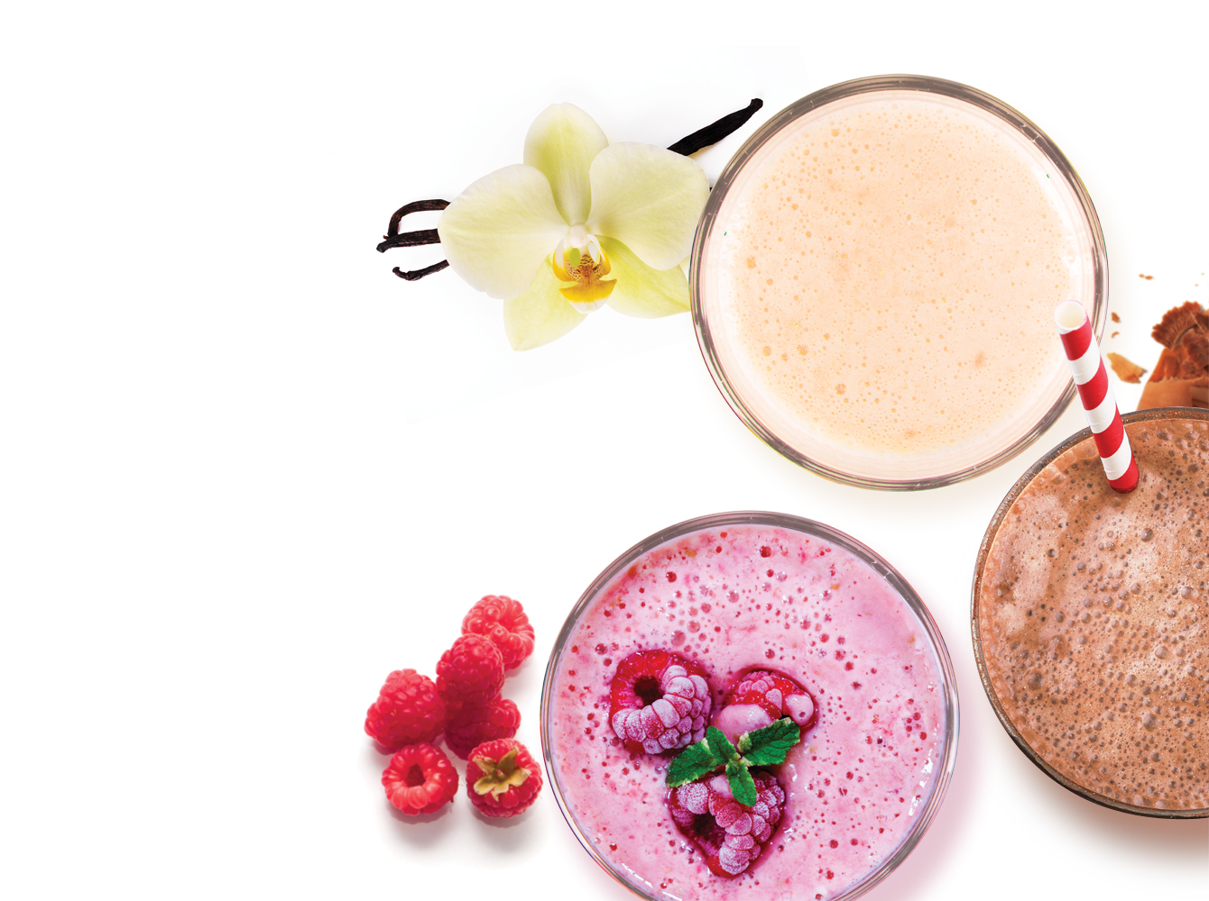
Delicious
Light and airy flavors
Notes:
Daily Delicious Beauty Shakes have only natural flavor!
After a year and a half of development, we have created a unique product with natural and airy flavor.
3 of the most popular flavors in the world:
Vanilla (The subtle flavor of soft ice cream with a hint of sweet spice is sure to please.
Raspberry (The sumptuous flavor of raspberry with its characteristic tang will delight both young and old).
Chocolate (The delicate flavor of chocolate will bring you back to your childhood, while the undertone of vanilla ice cream makes this shake the perfect light dessert).
Amazingly sweet, but not harmful for the body!
It was possible to create pleasing and nourishing dessert that can be added to your diet as a meal replacement! It is truly unique.

Slide 15

Erythritol and Stevioside
Natural sweeteners
Notes:
The quest for a means of limiting sugar intake while still enjoying sweet treats means the perfect sugar replacer is becoming more and more of a Holy Grail among food scientists. We also took up the task and, after thorough research, chose a natural sweetener with a popularity that continues to skyrocket: erythritol.
What makes erythritol different from other sugar alcohols?
First of all, its sweetness profile is very close to sucrose, and it is 60%-70% as sweet.
Secondly, it contains far fewer calories, from 0 to 0.2 Cal/g, depending on the measurement methodology.
Thirdly, it has glycemic index of zero, i.e. erythritol has no effect whatsoever on blood sugar levels.
Fourthly, it has an extremely low insulin index. It has no noticeable effect on insulin output levels, nor does it affect the body’s levels of cholesterol, triglycerides and other biomarkers.
Moreover, erythritol metabolism occurs in a completely different way from that of sugar, which is probably the most important feature distinguishing it from sugar alcohols. 90% of erythritol is absorbed into the bloodstream through the walls of the small intestine, and after some time is removed from the body with the urine. Only 10% of the erythritol reaches the part of the intestine where the gut bacteria are found, but the erythritol does not undergo any enzymatic reactions nor is it digested, but leaves the body in a natural way.
Additionally, erythritol is not digestible by bacteria found in the mouth. A three-year study has shown that erythritol provides even better protection against dental cavities than xylitol or sorbitol.
It is the only sugar alcohol considered natural.
Erythritol exists in nature in small quantities in a number of fruits (e.g. pears, melons and grapes) and mushrooms. It is this fact that distinguishes the sweetener from such artificial sugar replacers as aspartame and sucralose. On the other hand, erythritol crystals do not grow on trees. They are made industrially from corn through fermentation.
Does erythritol have a “darker side”?
Many studies have failed to find any negative effects from the consumption of erythritol. It is recognized as a safe food additive in all of the world’s major countries under the number E968. Nevertheless, it should be taken into account that in large quantities (over 50 grams at once), erythritol can act as a relaxant. A safe one-time serving is usually given at 30 grams, or five teaspoons, which realistically should suffice for any dessert.
Another positive feature of erythritol is that it you do not build a tolerance to it and it is not addictive like sugar.
Stevioside is a natural sugar substitute, which has rightfully earned its current status as one of the most popular sweeteners in the world. Stevioside provides those suffering from diabetes or obesity to remove sugar from their diet while still enjoying sweet tea, jam and other treats.
How is stevioside produced? Stevioside is a unique glycoside taken from the leaves of the stevia plant. This plant finds its origin in South America, but for over half a century has been successfully cultivated in the U.S.A., Japan, China, Canada, India and even in the southern regions of Russia. Stevia can even be grown at home — the perennial plant is perfect for windowsill overwintering, producing a plentiful harvest every summer.
The popularity of stevioside as a natural sugar replacer is easy to explain: not only does it sweeten, it actually benefits your health. Stevia’s sweet leaves are rich in glycosides (which is what gives them that flavor), as well as vitamins C, E, B1, B2 and D, as well as amino acids, essential oils, carotenoids, flavonoids, saponins, manganese, potassium, zinc, magnesium, chrome, phosphorus, iron, calcium and other microelements.
Many studies conducted in different countries around the world have shown that the regular consumption of stevioside provides health-enhancing benefits to the human body.

Slide 16
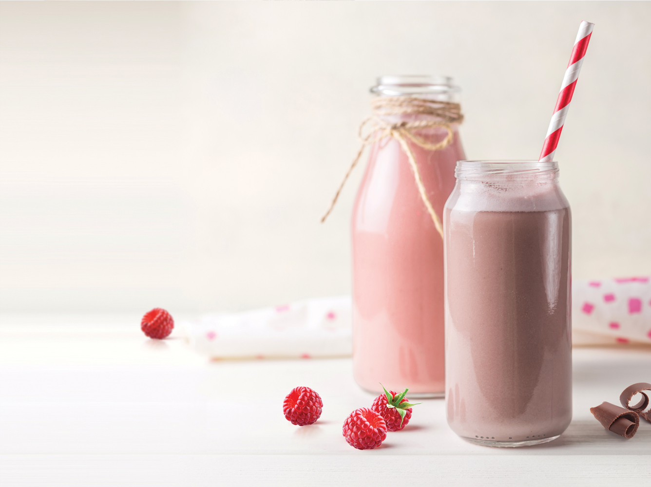
Convenient
All it takes is a couple of minutes

Slide 17
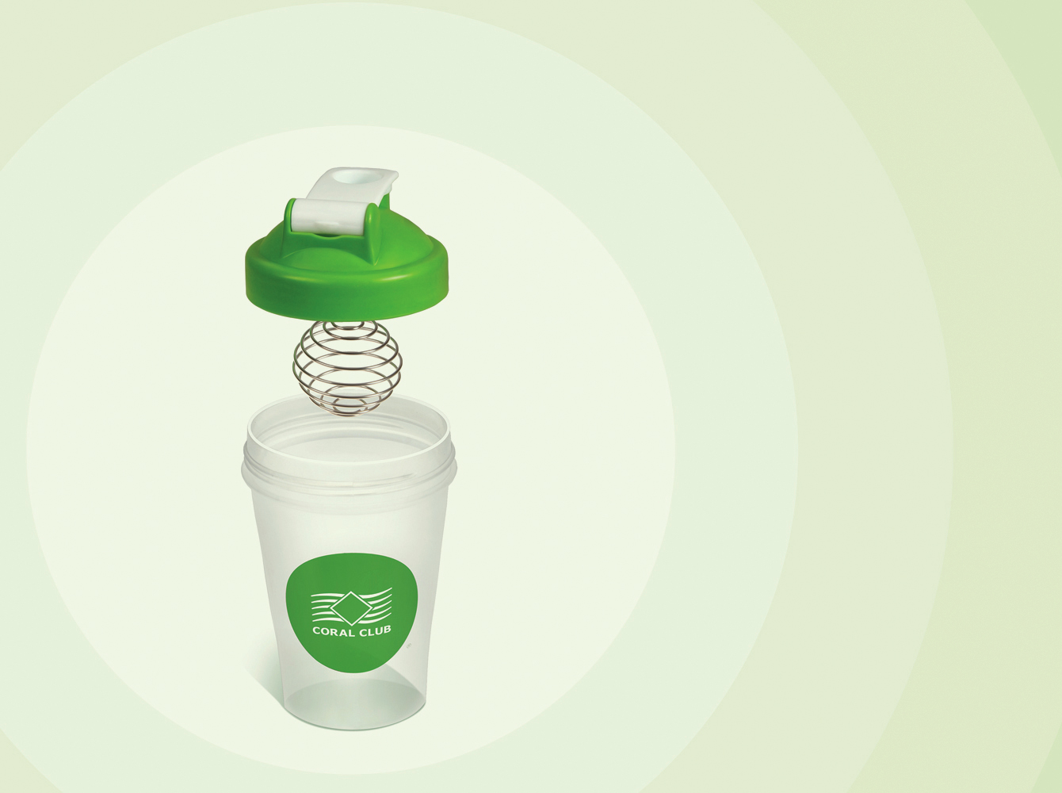
Smartshaker
1
Leak proof screw-on cap
2
Wire whisk ball from surgical-grade stainless steel
3
Easy-to-fill wide opening
High-quality BPA-free plastic
4
Notes:
The optimal solution for preparation of protein cocktails and more. The Smartshaker is a universal device for preparation of a variety of blends. For example, our protein Beauty Shake or Colo-vada mix, which is well known for its difficulty to dissolve. You can even use the Smartshaker to make an egg omelet!
All it takes is a couple of minutes, a shaker and some milk to prepare the Daily Delicious Beauty Shake.
Add one scoop of shake mix to milk, shake it well and it is ready!
The Smartshaker is quick and easy to use. It is compact and light; take it with you anywhere you go. The stylishly designed bottle has a flip cap and spout that make for convenient pouring or drinking.
CCI's Smartshaker is made of high-quality BPA-free plastic that makes it perfectly safe to use and wash. Made of surgical-grade stainless steel, the wire whisk is designed to mix any cocktails, or other blends, faster and better than regular bottles with strainers.
We are proud that our shakers:
are made of high-quality BPA-free plastic
have leak proof screw-on cap
have snap-on lid
have easy-to-fill wide opening
have wire whisk ball from surgical-grade stainless steel
have measuring scale on the side of the bottle
come in two perfect sizes – 400 mL and 600 mL
Smartshaker form Coral Club – no more clumps!

Slide 18
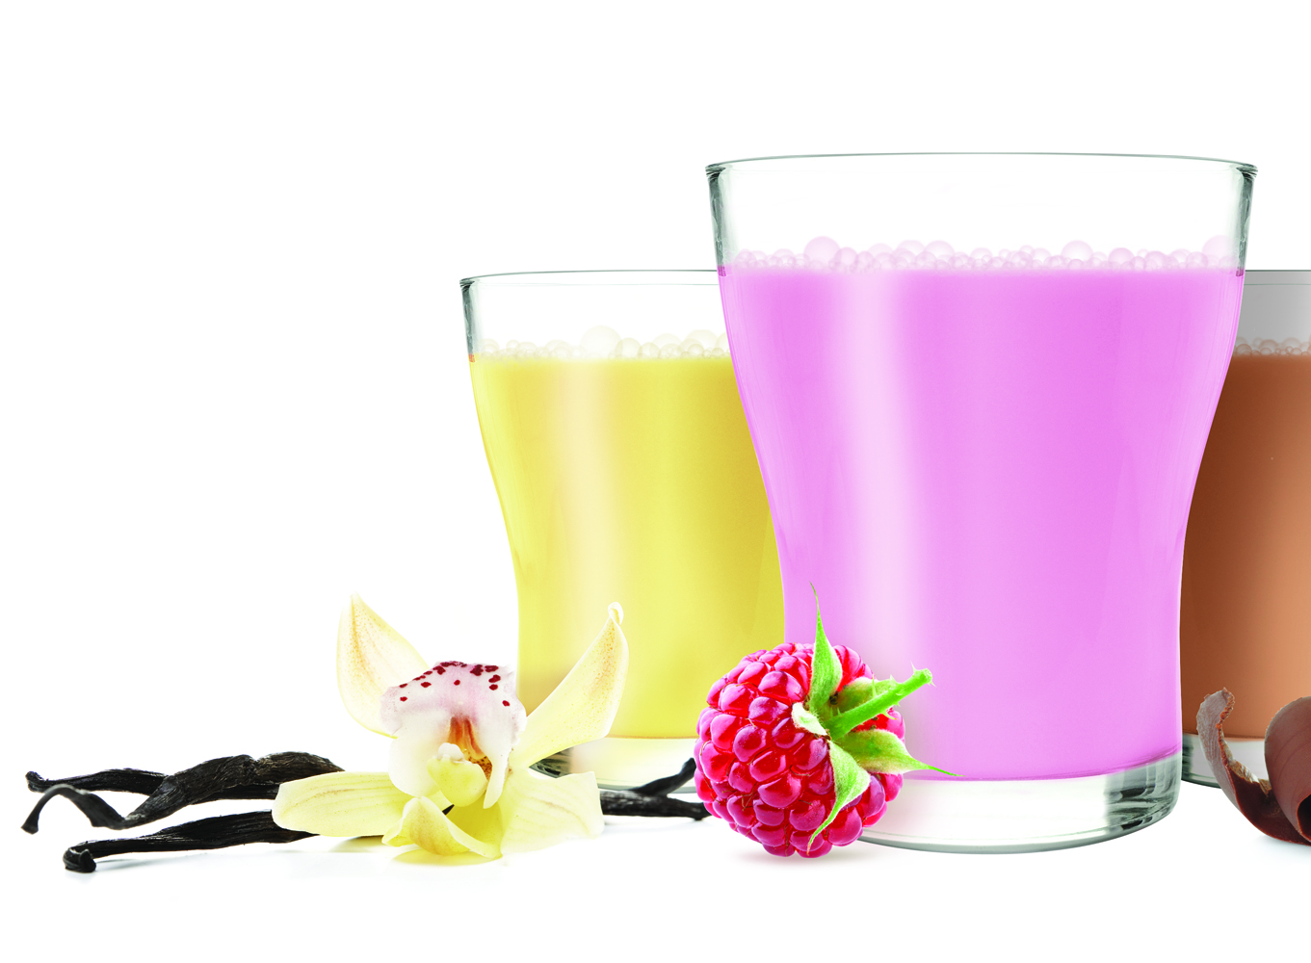
Affordable
1 shake is only
$22
+ the cost of milk
Notes:
What is the price of the healthy and delicious shake?
1 shake is only $22 + the cost of milk

Slide 19

How Daily Delicious can Improve Your Life
Svelte not Scrawny
1 or 2 shakes per day replacing a meal or as a snack
Notes:
Oftentimes dieting results in vitamin and mineral deficiencies, leading to pale-skinned faces, poor hair and nail quality and other unpleasant symptoms.
Daily Delicious will help you lose weight without harming your body. The combined effect of the three kinds of proteins give you a long-lasting sense of satiation, which helps you to reduce portion sizes and how many calories you consume each day. All you need to do is add Daily Delicious to your diet as a meal replacement.

Slide 20

Building a Slimmer Body
Take together with one of the regular meals as an additional source of protein
+ 20 minutes before working out or within the hour after
Notes:
A slim, firm body with developed musculature is always beautiful. But not everyone is able to get the chiseled look they want on a normal amount of food. In combination with weight training, Daily Delicious helps to increase muscle volume by bathing cells in the nutrients they need to grow.
You will feel a burst of energy that will allow you to surmount even greater physical challenges and your muscle fibers will recover more quickly after intense workouts.
Daily Delicious should act as an addition source of protein together with a regular meal, as well as 20 minutes before the start of a workout or within the hour following one.

Slide 21

Our Lives are Active
1 or 2 shakes a day or when hungry and no time for a proper meal
Notes:
The modern pace of life often leaves us without the time to eat a complete diet. Some say that we have to eat 5 times a day, others say that 3 meals a day is enough. With Daily Delicious, you can stay on the go and remain healthy and full of life. Daily Delicious Beauty shakes provides you with a whole range of nutrients that will help your body’s proper function.
The combination of plant- and animal-based proteins will keep you feeling full (thanks to the different rates of digestion of each kind of protein). A shake a day will fill you with energy, beauty and overall vitality.

Slide 22

Beauty shakes are perfect for:
People who care about the appearance of their skin, hair and nails
Those who value their time
People with an eye on their weight
Athletes
Those who tire quickly or are under stress
People with digestive problems
Notes:
DDBS are perfect for those who:
Value their time
Like everything delicious and natural
Eat right
Take a good care of themselves
Like sports and outdoor activities
Also, it is good for:
Athletes
Those who tire quickly or are under stress
People with digestive problems
During recovering after surgeries or injuries
People with an eye on their weight
People who care about the appearance of their skin, hair and nails
Elder people

Slide 23
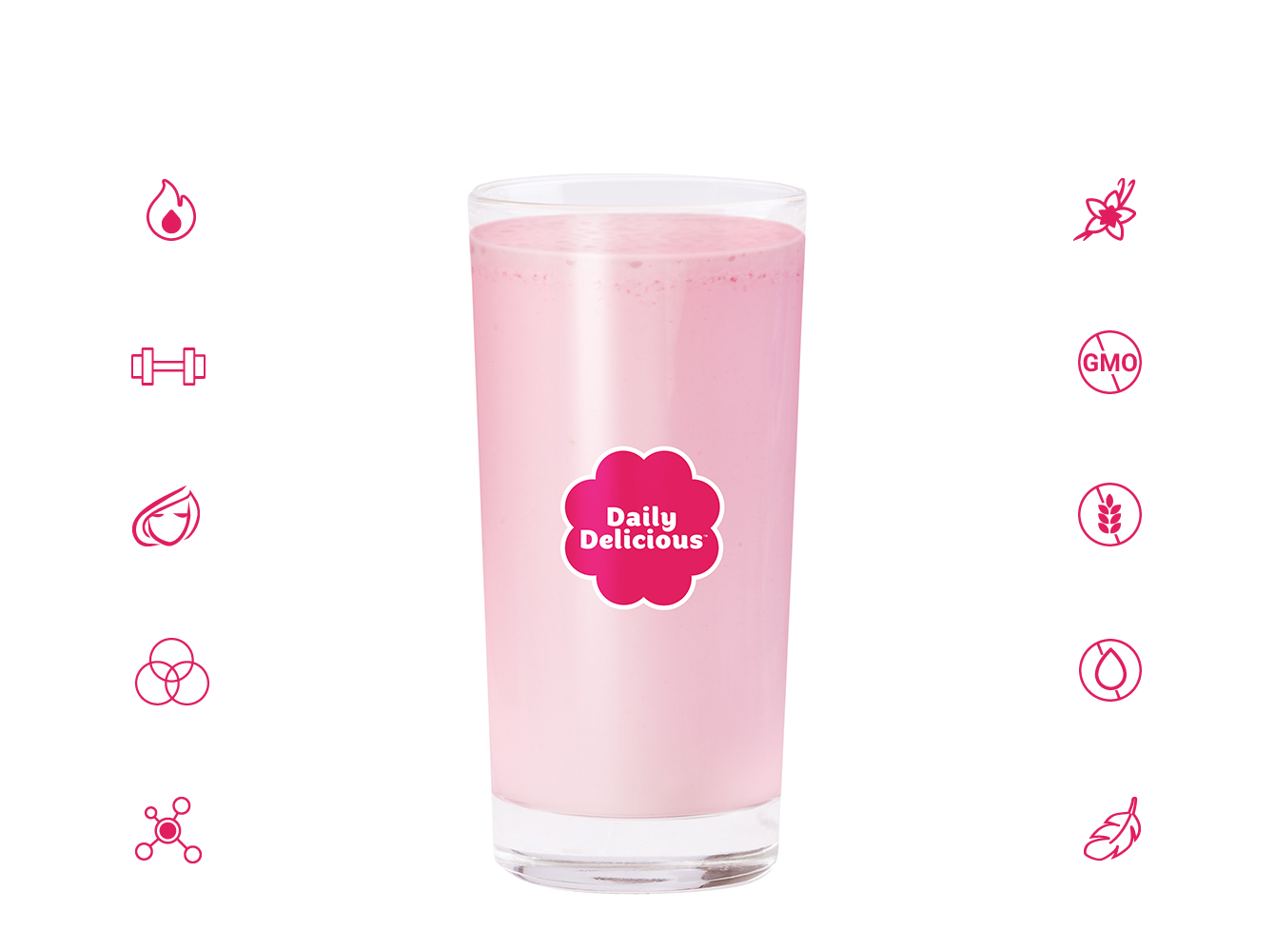
Daily Delicious Beauty Shake consists
195 Calories
Natural flavor
21 g protein
GMO-free
11 beauty-enhancing nutrients
Gluten-free
protein formula
Trans fat free
Verisol® Collagen
Light and fluffy

Slide 24


