Slide 1
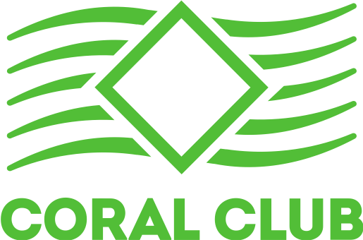
CORAL-CLUB.COM

Slide 2
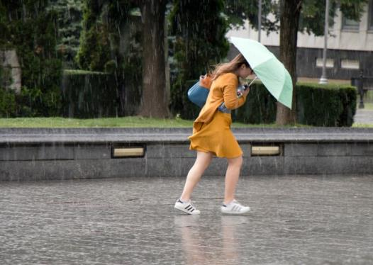
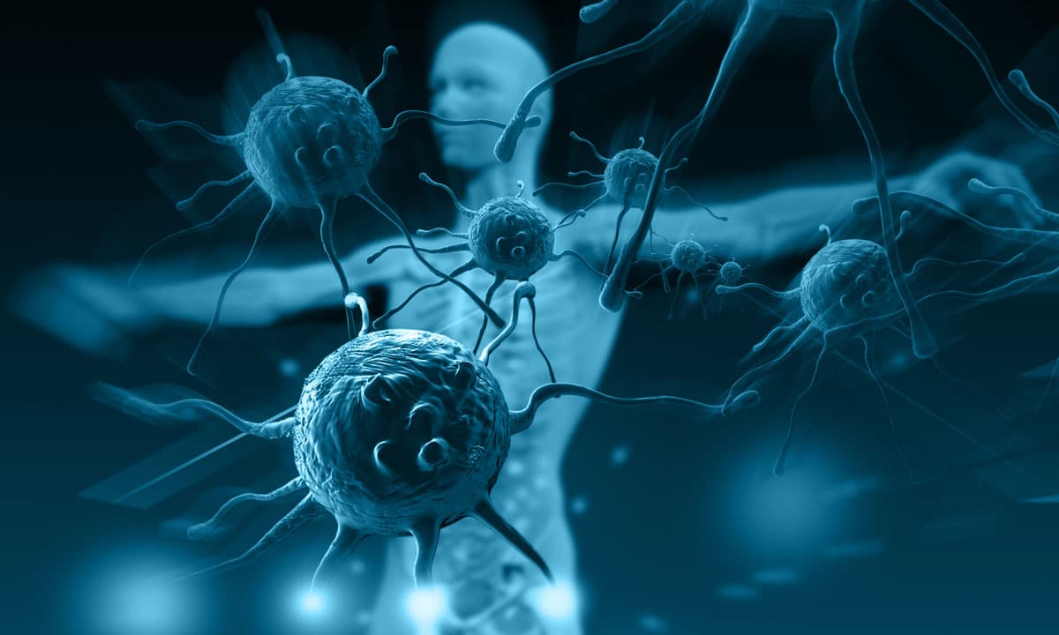
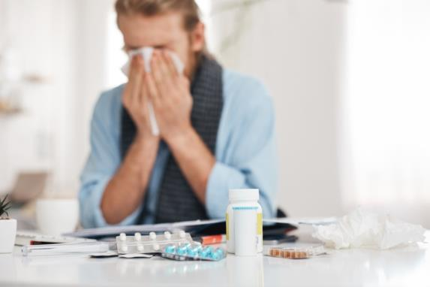
Flu season
Favourite time of year for viruses and bacteria
Temporary depression of the immune system
Insufficient attention to our health
Notes:
Flu season
The common cold and the flu are viral infections of your nose and throat (upper respiratory tract). Every year, usually between November and March, instances of cold and flu increase.
Why is that? Seasonal factors are added to common risk factors, and there is an increased load on our immune system.
Common risk factors: • environmental factors; • insufficient attention to our health; • stress, which reduces the body’s resistance to viruses; • fatigue;
• lack of sleep.
Seasonal risk factors:
Lower temperatures and humidity are more favorable for the cold and flu viruses
depression of the immune system

Slide 3
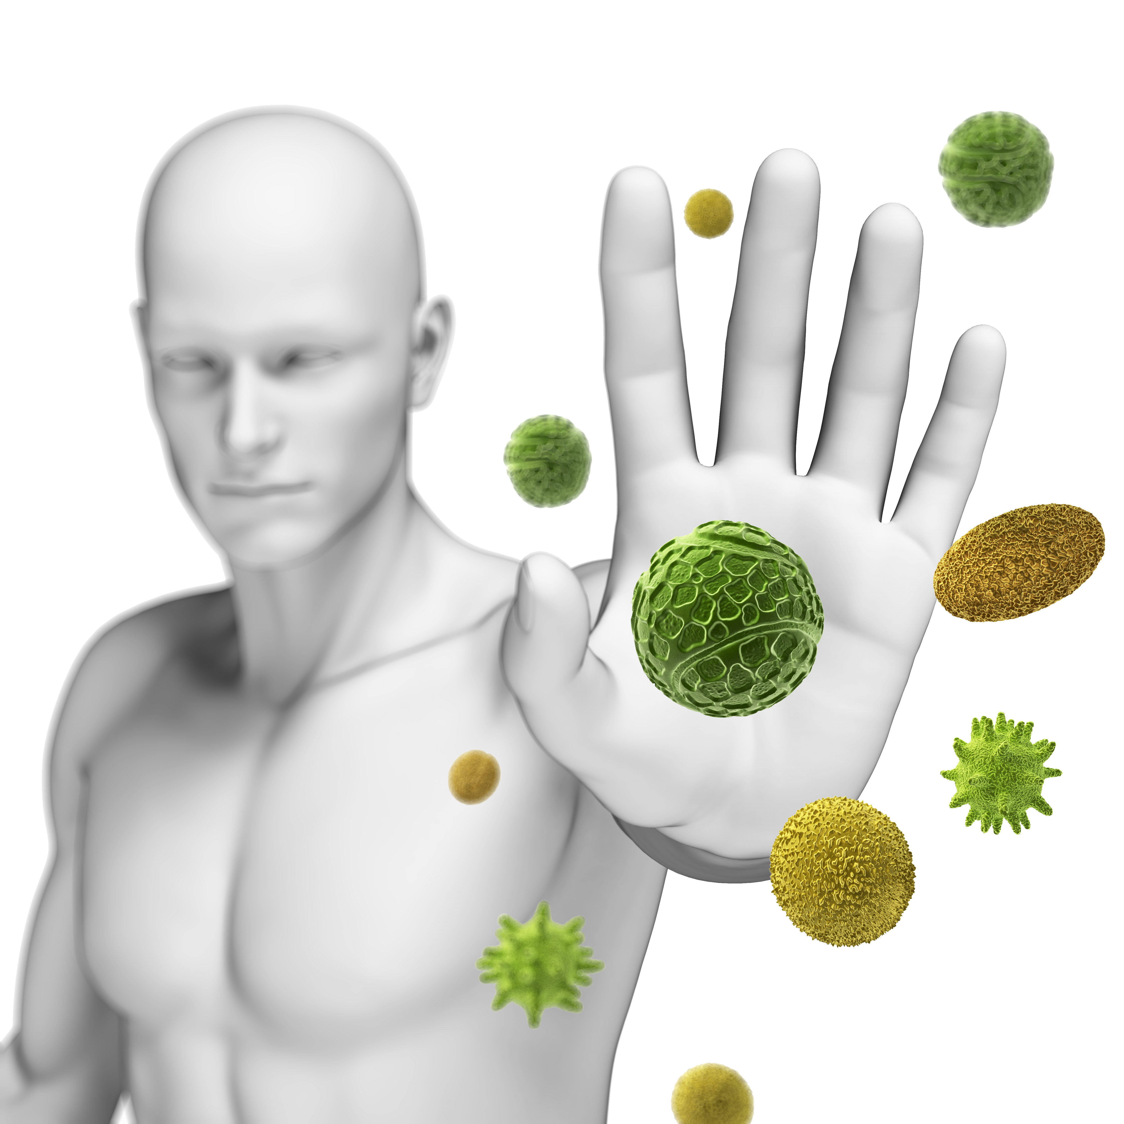
Prevention is the best protection!
It is impossible to isolate yourself and your loved ones from contact with carriers of the infection.
Boost your immune system
and protect your body!
Notes:
Most people don’t have the opportunity to isolate themselves from the world. People go to work, use public transportation, communicate with colleagues and friends.
Some people wear facemasks, but it’s hard to go to a business meeting or on a date wearing one.
The best solution to the problem is to boost the immune system to help the body protect itself.

Slide 4
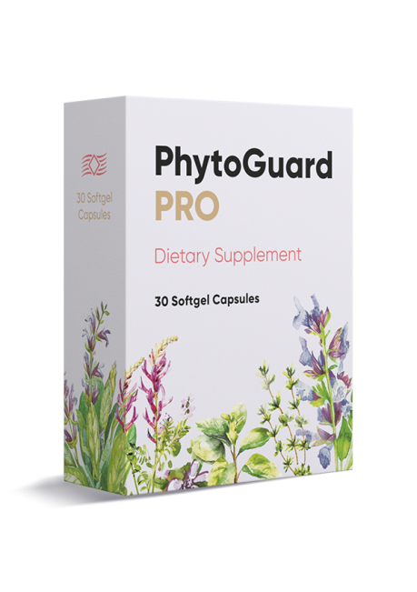
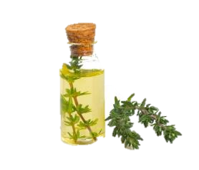
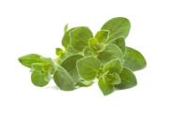
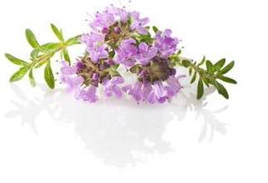
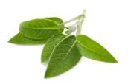
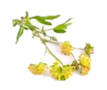
Notes:
PrytoGuard Pro is a product that helps to activate the immune system and improve antioxidant protection.
A complex of beta-glucans, essential oils and plant extracts helps to increase the body's resistance to various infections and improve overall health.

Slide 5
Is recommended for people who:
Want to boost their immunity in any season
Prefer prevention to treatment
Spend time in close proximity with other people
Choose products based on natural ingredients
Notes:
A well-functioning immune system is crucial for staying healthy.

Slide 6
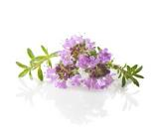
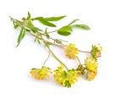
Beta-glucans (β-glucans) + complex of essential oils and extracts
COMBINATION OF NATURAL COMPONENTS, for health and immunity support
Notes:
Beta-glucans (β-glucans) belong to a group of biologically active natural compounds, polysaccharides.
This component supports the immune system, has anti-inflammatory properties and increases the flexibility and strength of blood vessels.
6

Slide 7
Beta-glucans (β-glucans)
Beta glucans’ ability to stimulate immunoactive molecules and improve the immune-modulation within the body is remarkable. *
Beta-glucans –
Naturally occurring polysaccharides
Notes:
Beta-glucans are the main component of the product.
When it comes to naturally boosting the immune system by optimizing its response to infections, beta glucans are crucial weapons in the fight to stay healthy.
In a study from Medicine and Science in Sports and Exercise, for instance, tests on mice revealed that beta-glucan may offset the negative effects of exercise-induced stress and increase the immune system's defense against upper respiratory tract infections.**
Beta-glucan is a substance found naturally in several foods, including oats, barley, and certain mushrooms.
* Beta Glucan Research: https://www.betaglucan.org/
**Exercise Immunology by M.Gleeson, N. Bishop and N. Walsh
7

Slide 8
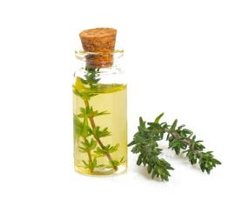
Oregano and thyme
These components give your immune system a leg up with its powerful antibacterial and antiviral properties.
Oregano and thyme essential oils
Notes:
Oregano and thyme essential oils contain certain compounds that have antibacterial properties.
People have traditionally used them for respiratory health, and they have become popular alternative remedies for cold and flu symptoms.
Essential oils help to soothe the throat.
These components are rich in antioxidants, which are compounds that help to fight damage from harmful free radicals in the body and reduce inflammation.
Adding a few drops of these essential oils to a humidifier can help your respiratory tissues fight off cold and flu more effectively.
8

Slide 9
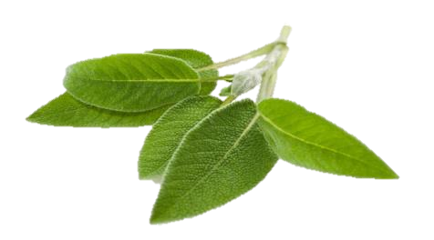
Sage
Immune system support
Sage leaves extract
Notes:
Sage leaves extract is rich in flavonoids, polyphenols and terpenes, which help to boost immunity.
Sage can help protect the body's cells from damage caused by free radicals due to its high antioxidant capacity.
For a long time, sage (Salvia) species have been used in traditional medicine for the relief of pain, protecting the body against oxidative stress, free radical damage, inflammation, bacterial and virus infections, etc.
Sage contains thujone, a potent antiseptic and antibiotic, which fights against common viruses, bacteria and fungi to assist your body’s immune system and help you recover faster.
Sage extract is found in many popular lozenges and cough syrups.
9

Slide 10
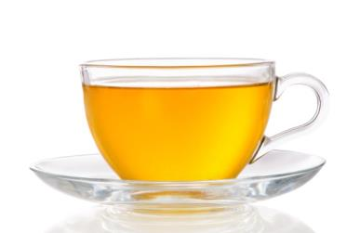
Astragalus
Has antibacterial and anti-inflammatory properties.
It has become famous for over the years is its powerful immune-boosting properties
Astragalus root extract
Notes:
Astragalus provides health benefits to a number of body systems.
Astragalus root powder extract is high in polysaccharides, flavonoids, saponins, amino acids, polysaccharides, tannins, essential oils and vitamins that enhance immune function.
Astragalus has antibacterial properties and helps to neutralize the effects of oxidative stress.
In terms of reputation, boosting the immune system is astragalus’ claim to fame. It has been used in this capacity for thousands of years.
10

Slide 11
CORAL-CLUB.COM
Notes:
11

Slide 12
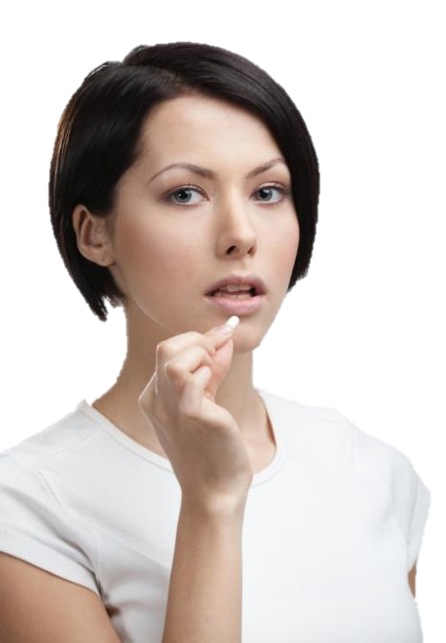
EASY: 1 capsule once a day will boost immunity when it is especially needed and important.
CONVENIENT: blister pack protects the capsules and doesn’t take too much space in your bag.

Slide 13
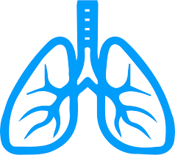
HELPS
To boost the immune system
To relieve symptoms of the cold and flu
To maintain overall health
1 pack = 30 capsules in blisters

Slide 14
25 c.u. retail price
20 c.u. member price
13 volume points
CORAL-CLUB.COM

Slide 15
Easy and convenient 1 capsule once a day
Beta-glucans have immune-modulatory properties
Essential oils and extracts
relieve cold and flu symptoms
Antioxidant protection
to stay healthy and young

