Slide 1
Ca-Mg
Complex
Notes:
Presentation - a demonstration or display of a product or idea.
The purpose of the following presentation is to introduce our new product “Ca-Mg Complex” and to receive buy-in to your message from the audience. The message is: the superiority of the company products and that they can fulfill the customer’s need – healthy lifestyle.

Slide 2
Have you experienced any of the following?
Fatigue
Bone breaks & fractures
Low energy
Irritability
Anxiety
Loss of muscle mass
Irregular sleep pattern
Muscle spasms
Arrhythmia
Nervousness
Irregular blood pressure

Slide 3
Possible reasons?
Deficiency of
Ca
(Calcium)
Mg
(Magnesium)
Notes:
Very often, a deficiency of Ca and Mg can cause some of the aforementioned symptoms.
A deficiency of Ca interferes with bone mineralization which softens bone and makes it more brittle. Muscle mass is decreased, nerve cells are more excited, and muscle spasms can occur.
A deficiency of Mg causes fatigue, irritability, neuroses, depression, irregular sleep patterns, dizziness, increased heartbeat, irregular blood pressure, arrhythmia, muscle weakness, loss of appetite, immunodeficiency, and muscle spasms.

Slide 4
Ca & Mg in the body
Ca
Mg
53 %
99 %
is contained in:
Is necessary for:
Bone tissue
Dental tissue
Dentin & enamel
Bone tissue
20 %
is contained in:
Joint tissue
Brain
Heart
Muscles
Kidneys
Liver
Notes:
Calcium is an essential macroelement of the human body. 99% of Ca is necessary for dental, bone and joint tissues.
Calcium is primarily involved in building and strengthening bones, tendons, and ligaments. Calcium is stored in bone and can be extracted if there is a calcium deficiency in the diet.
Up to 53% of Magnesium is contained in bone tissue, dentin and enamel and around 20% in the brain, heart, muscles, kidneys and liver.

Slide 5
The roles of Ca and Mg
Stimulates the metabolism of enzymes, proteins, fats, and nucleic acids
Participates in the production of ATP
Regulates cell elasticity
Supports the acid-base balance
Participates in building of bones, ligaments, tendons, enzymes and hormones
Improves the metabolic process in blood cells
Normalizes the heart rate
Increases resistance to stress
Notes:
Calcium is primarily involved in building and strengthening bones, tendons, and ligaments. Calcium is stored in bone and can be extracted if there is a calcium deficiency in the diet.
Furthermore, calcium is responsible for the proper functioning of multiple enzymes and hormones and improves metabolic processes.
It normalizes the functioning of the nervous system and stimulates the activity of vasopressin and serotonin hormones, which improves the central nervous system’s response to stress
Calcium helps to regulate cell elasticity and normalizes cerebral blood flow.
Inside the cells of the heart muscle calcium binds to the protein troponin and together they regulate the heart rate.
Magnesium is considered “the heart mineral”. It helps to normalize the heart rhythm and reduces the myocardium’s need of oxygen.

Slide 6
How magnesium effects health.
Notes:
Research on how magnesium effects health
Research conducted in Great Britain, Finland, Canada and USA has shown that people who live in regions where water is rich in magnesium have lower incidence rates of heart related deceases, atherosclerosis and hypertension. Researchers believe that food rich in magnesium helps to support health of blood vessels and helps to prevent the accumulation of “bad” cholesterol and formation of cholesterol plaques. That is why people who receive enough magnesium in their diet experience fewer blood clots.

Slide 7
Balance is important
Ca
Mg
Notes:
Calcium and magnesium both help and compete with each other. Calcium aids in the contraction of muscle tissue (both smooth and skeletal), while magnesium does the opposite – relaxes muscle. Furthermore, magnesium ensures that cells receive their calcium supply in the correct amount. Optimal calcium adsorption and its minimal excretion can be ensured only if calcium and magnesium are present in the body in the correct ratio.

Slide 8
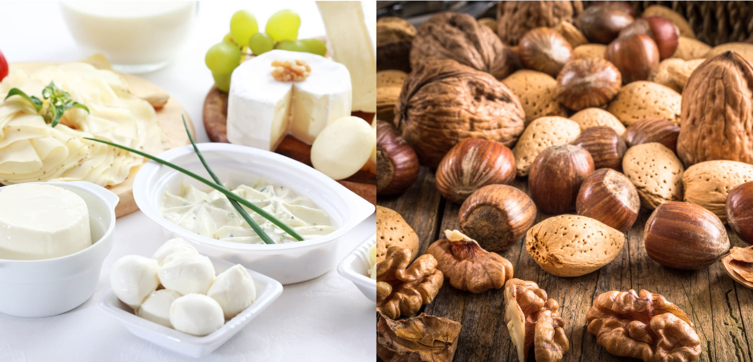
Sources of Ca & Mg
Notes:
Calcium (Са)
The best sources of this mineral: milk and dairy products, soy, sardines, salmon, peanuts, walnuts, sunflower seeds, dried beans, green vegetables.
Magnesium (Mg)
The best sources of this mineral: nuts, sprouts, beans, green vegetables, soy, shrimps, mussels, oysters, crab meat.

Slide 9
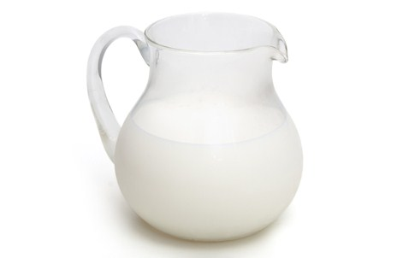
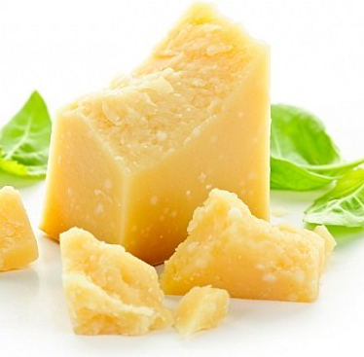
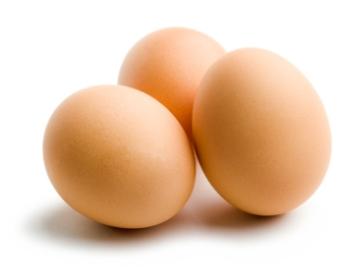
Daily intake
Ca
1000 mg
Mg
400 mg
660 g
cottage cheese
1100 ml
cream 10%
80 g
parmesan cheese
10
bananas
2 kg
chicken
1 kg
Crab meat
1300 g
peanuts
33
eggs
1700 g
potatoes
Notes:
Recommended daily intake:
1000 mg of Calcium and 400 mg of Magnesium, which equals to:
Calcium:
660 g of cottage chees,
1100 ml of 10% cream,
80 g of parmesan cheese,
1 kg of crab meat,
1300 g of peanuts,
33 eggs.
Magnesium:
10 bananas,
2 kg of chicken,
1700 g of potatoes.

Slide 10
What else?
Notes:
Ca-Mg Complex:
Minerals for healthy heart and strong joints
Ingredients: Calcium, Magnesium, Silica, Boron, Vitamin K, and Vitamin D₃.
This complex was created based on the latest research on the respective roles and interaction of calcium and magnesium, their pathway to bone tissue and their absorption.
«Ca-Mg Complex»:
Helps to improve the metabolism of calcium and magnesium
Has a positive effect on heart and blood vessels
Promotes regular heart rate
Helps strengthen musculoskeletal tissues

Slide 11
Unique characteristics of
«Ca-Mg Complex»
Optimum proportions of Calcium and Magnesium
Only organic forms of minerals
75–90% digestible
Consists of synergic components that help digestion of Calcium & Magnesium: silica, boron, vitamin К₂, vitamin D₃
Notes:
Organic forms of minerals help 75-90 % digestion of the Ca and Mg, while non-organic forms only for 50%
Silica helps to increase the amount of protein (Collagen and elastin) in bones.
Silica plays a vital role in the growth and maintenance of bones and joints by taking part in the mineralization of bone tissue. In addition, silica prevents “bad” cholesterol from entering the blood stream and binding to vessel walls.
Boron is a very important element. Together with silica, vitamins K and D increases the absorption and improves the metabolism of calcium, magnesium and phosphorus. It also prevents the loss of Ca and Mg though the kidneys and aids in the conversion of vitamin D in more active form.
Vitamin К₂ is a fat-soluble vitamin, which is created by microorganisms that are found in the intestines.
This vitamin is involved in the synthesis of complex proteins and blood clotting. It also supports blood vessel walls.
In tandem with magnesium, it participates in the creation of ATP and the conversion of sugar into glycogen, which promotes the energy exchange.
The main function of vitamin К₂ in this complex is aiding the absorption of calcium and an interaction of calcium and vitamin D.
Vitamin D₃ (Cholecalciferol). It is the most active forms of the group D vitamins.
D₃ helps to maintain the optimum amount of calcium in the blood, increases calcium absorption in the small intestine and promotes the transport of calcium from blood to the bones.
D₃ helps to maintain a balance of calcium in the body by moving some of the calcium in the bones to the blood if there is a calcium deficiency in the diet.
By improving the absorption of calcium and magnesium, D₃ helps to protect nerve cell membranes from damage.
The D₃ and calcium exchange helps to improve the function of the thyroid gland. Conversely, the deficiency of D₃ can lead to issues with thyroid, bone mineralization, and muscle weakening.

Slide 12
Who needs it?
Notes:
«Ca-mg complex» — beneficial dietary supplement for:
People with heart and blood pressure problems
People who suffers from osteoporosis
Women after 40
Seniors
People who suffers from depression
People who experience problems with musculoskeletal system
Athletes during intensive exercises

