Slide 1

Start with water

Slide 2

Water is the driving force of all nature
Notes:
Water is the driving force of all nature. This is a description of water by Leonardo Da Vinci.

Slide 3
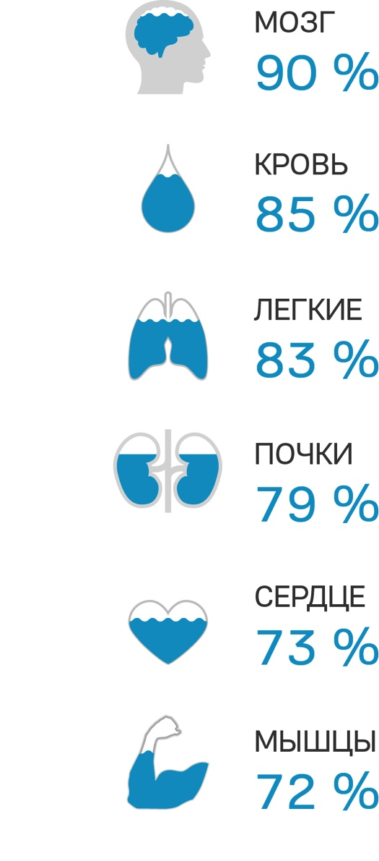
Вода – основа нашей жизни
Water is the basis of life
Brain
Blood
Lungs
Kidneys
Heart
Muscles
Notes:
What are a person’s needs?
Everyone’s answer will be different, but correct. A person’s needs to live a fulfilling life are numerous, however, there are some things that are essential to survival itself. Air, water and food.
These things (that we get from our environment) give us energy and vitality, and thus promote a fulfilling, active and healthy life. Our health, longevity and capacity to work are directly related to the quality of the air we breathe and the food & water that we consume.
Today, we will discuss water.
Water is the basis of life. 2/3 of the earth’s surface is covered in water! Water is the second most essential element on earth (oxygen is the most important). A person can live without water for only 3 days. We are made of water (two thirds)
Brain up to 90% water
Blood up to 85% water
Lungs up to 83% water
Kidneys up to 79% water
Heart up to 73% water
Muscles up to 72% water
Ancient villages were established along river banks, water wells with spring water were an assurance of wellbeing and a good harvest. Our ancestors gave great importance to the quality of water and even considered it to have healing properties.

Slide 4
8 reasons to drink water
WEIGHT CONTROL
ENERGY
PAIN RELEIF
HEALTHY SKIN
HEALTHY DIGESTION
HEALTHY JOINTS AND MUSCLES
REGULATION OF BODY TEMPERATURE
REMOVING TOXINS
Notes:
PAIN RELIEF. Migraines, headaches, pain in the lower back, joints, muscles and other areas are possible symptoms of dehydration.
85% of the human blood consists of water, when the blood becomes dehydrated, it thickens, which negatively affects the body.
ENERGY. Water is an important source of energy for the body. Water delivers oxygen and nutrients to every cell in the body and promotes a healthy metabolism. If the body is oxygen deprived it results in low energy.
WEIGHT CONTROL. Water increases the metabolism, regulates appetite and reduces feelings of hunger. Water does have any calories and it is an important part of any diet. Water consumption helps to burn fat. Experiments show that consuming 1 glass of water increases the metabolism by 30%. 1L of water helps to burn 100 calories. Although that seems like a small amount, it adds up to 3000 calories/month and 36000 calories/year, which can help you get rid of 5 kg of fat without ever stepping on a treadmill.
HEALTHY DIGESTION
Water promotes healthy digestions and bowel movements.. It increases the metabolism and promotes the creation of the optimal amount of stomach acid. Water helps to remove excrements from the intestines and helps to avoid constipation.
HEALTHY JOINTS AND MUSCLES
Water takes part in protein synthesis in muscles, which helps to keep our muscles and ligaments elastic. There is a lot of water in joints, which protects joints and cartilage by acting as a lubricant. When dehydrated, the amount of synovial fluid is reduced, which reduces joint mobility.
REGULATION OF BODY TEMPERATURE
Water has a high thermal capacity and thermal conductivity. It cools down the body 14 times faster than air. The human body generates enough heat in 1 hour to bring 1 L of ice-cold water to a boil. If the human body was an impermeable case, within 1 hour the body temperature would rise by 1.5°С. In 40 hours, it would reach 100°С. Water helps us to regulate body temperature while external temperature changes.
HEALTHY SKIN
Cell dehydration leads to a loss of collagen, which results in reduced skin elasticity. Using moisturizing creams, oils and lotions can help, but it is better to avoid collagen loss in the first place. Hydrate your skin from within by drinking water, which will also help to flush toxins, increase skin elasticity, prevent signs of aging.
REMOVING TOXINS. Without water, the liver and kidneys (the body's natural filters) cannot function normally.
Water helps to remove waste and toxins from the body.

Slide 5
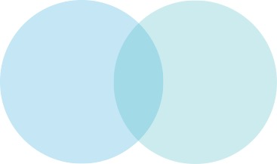
Essential to health
Quality of water
Quantity of water
Notes:
In order to maintain a healthy body, it is important to remember 2 requirements: quantity and quality of the drinking water.
И для полноценного существования организма к воде предъявляется всего 2 требования: количество потребляемой воды и ее качество.

Slide 6

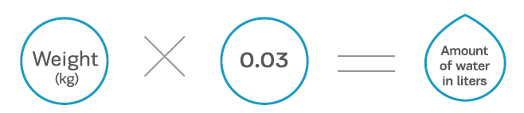
How much water should you drink?
Notes:
You can calculate the amount of water that you should drink by multiplying your weight (in kg) by 30 ml.

Slide 7
When should you drink water?
Notes:
1-2 glasses will restore the water balance after the night.
1 glass before a meal will help to control portion size by creating a feeling of fullness.
2 glasses before each meal and a small reduction of your regular portion size can help you lose excess weight.
Drinking 1 L of water during the day will help to burn 100 calories, which is equivalent to 5kg of fat per year!
Do you want to increase your metabolism? Drink cold water!

Slide 8
What kind of water should you drink?
Physical properties
Mineral balance
Taste
Notes:
The following define high quality water:
1. Physical properties
High quality water should contain the optimal amount of macro and microelements that are beneficial for the human body. This type of water helps to regulate the optimal salt-water and acid-base balances in the body. Filtered and bottled water rarely has these properties.
2. Mineral Balance
Minerals are like keys. They work inside and outside of cells and open the doors that lead to health and longevity. A specific amount of micro and macroelements is necessary for maintaining a healthy body. Drinking water should contain an optimal amount of minerals. Too high or too low levels of minerals can harm the body.
3. Taste
The taste and smell of water depend on its chemical composition, which in turn depends on external elements (from natural sources or added in the production process) present in water. Chlorination (and other disinfection methods) also have a profound effect on water quality.

Slide 9
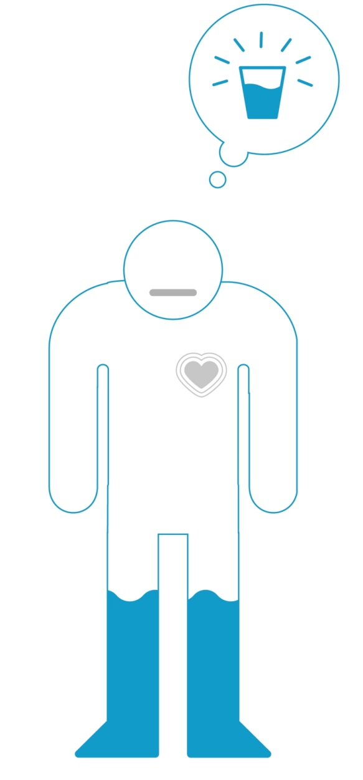
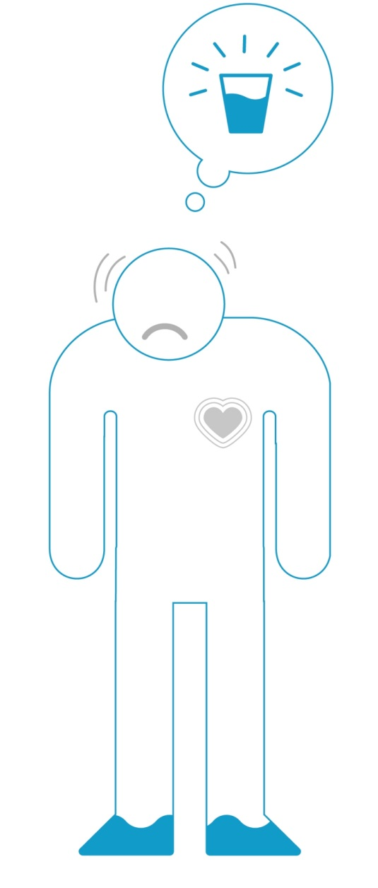

Dehydration
Notes:
Dehydration of the following percentages can lead to:
•1% - feeling of thirst;
•2% - feelings of anxiety, loss of appetite and capacity to work;
•4% - nausea, dizziness and fatigue;
•6% - loss of coordination and slurred speech;
•10% - thermoregulation is compromised and cell death occurs;
•11% - medical intervention is needed;
•20% - death is a possibility.
The majority of instances of dehydration lead to premature aging.

Slide 10
Did you know?
1 can of soda
1 glass of water
35 grams of sugar
0 grams of sugar
=
=
140 калорий
0 калорий
Notes:
We often replace water with juices, tea, coffee and soda.
1 can of soda contains 35 g of sugar and 140 calories.
Water contains no sugar and no calories.
Each cell of our body needs water. Do you wash dishes or your hands with soup?

Slide 11
A turn-key solution
Quality
Quantity
Portable
Notes:
Coral Club has created a turn-key solution that will help you consume water
in the right quality
in the right quantity
in a convenient way.
The Water Pack should undoubtedly be your first step to starting a healthy, full of energy life.

Slide 12
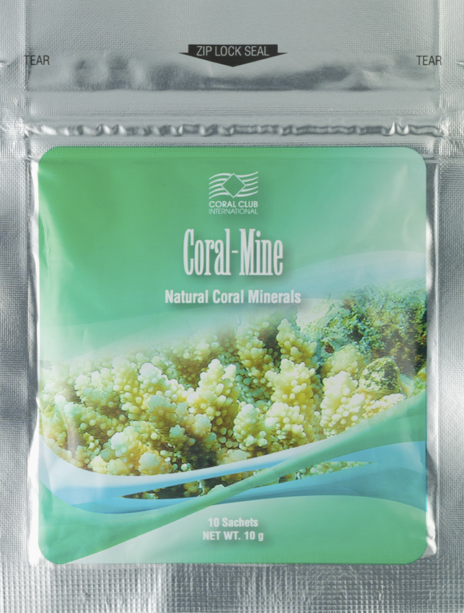
Coral-Mine
Changes the physical and chemical properties of water
Contains the optimal balance of micro and macroelements
Improves the “taste” of water for every cell in the body
Notes:
30 sachets of Coral-Mine are enough to enrich 45 liters of water.
1. The mineral composition of Coral-Mine is capable of changing the chemical and physical properties of water:
Coral-Mine is a natural sorbing agent.
Coral-Mine makes water more basic.
Ionized minerals contained in Coral-Mine improves water absorption.
2. Coral-Mine normalizes the mineral balance in the body as well as the functioning of various systems and organs in the body. Magnesium and calcium are effective at restoring the functioning of the musculoskeletal system and promote the regeneration of bone and connective tissues. In tandem with sodium, they help to support cardiovascular health. Magenesium is important in the functioning of the nervous system and helps to reduce depression. Vitamin C has an antioxidant effect and helps to prevent premature aging. It is worth noting that the elements contained in Coral-Mine have a synergetic effect. The benefits of each of the components are increased due to the presence of the other components.
3. The minerals, that are contained in Coral-Mine, are more easily absorbed by the body when dissolved in water. This makes it easier for the cells in the body to absorb water and top up their water reserves. Coral-Mine makes water softer, tastier, healthier. Drinking water with Coral-Mine is simple and pleasant.

Slide 13
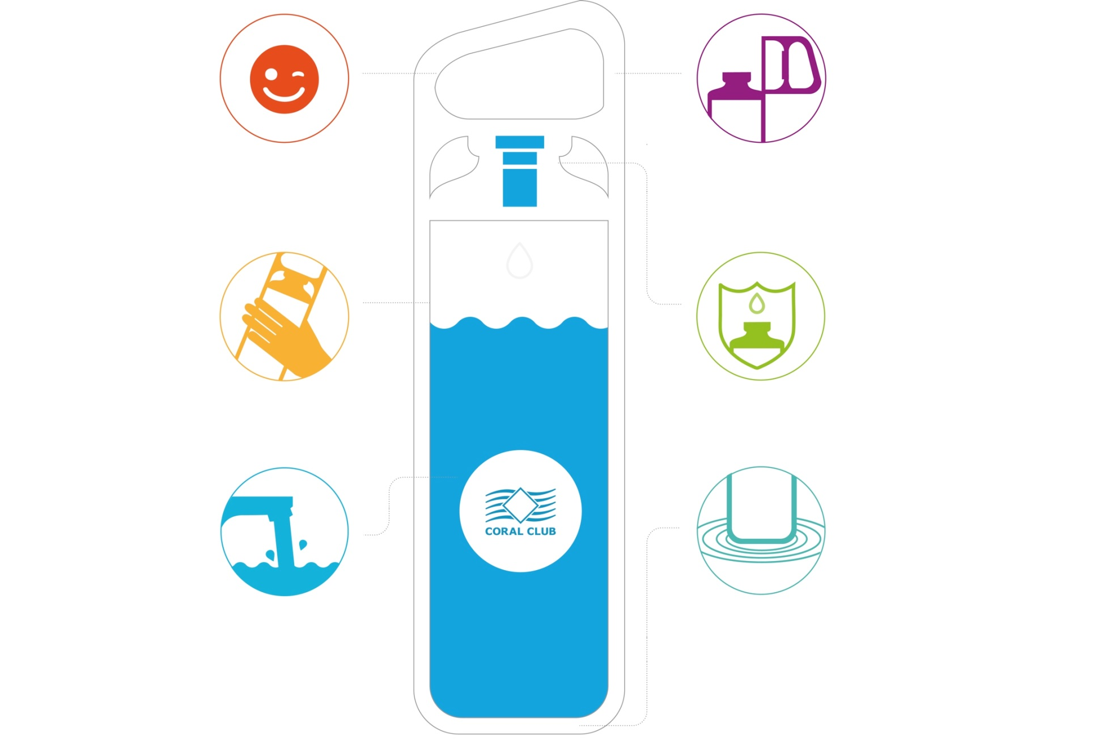
Always with you!
INSPIRATION INCLUDED
ERGONOMIC DESIGN
NO-WORRY CAP
HYGIENIC CHAMBER
EASY TO FILL AND WASH
CUSHIONED BASE
Notes:
The KOR Delta is an innovative hydration vessel that helps to preserve water’s beneficial properties. It is made of BPA and Phthalate free health-safe material.
The KOR delta bottle is a work of art. It is a beautiful combination of function, design and convenience.
Its state of the art features include:
NO-WORRY CAP. Opens with a simple push of a button and stays out of your way when you are drinking.
INSPIRATION INCLUDED. Motivational messages that inspire you with every sip.
ERGONOMIC DESIGN. The shape makes it comfortable to hold and the built-in handle makes it easy to carry with you.
HYGIENIC CHAMBER. Unlike most other bottles, the cap protects the spout from germs and dirt.
CUSHIONED BASE. Experience the comfort of a soft-cushioned anti-clip base that helps to protect furniture.
EASY TO FILL AND WASH. The spout is wide enough so that filling and washing the bottle is easy, while splashing is minimized.
Convenient size, easy to use!

Slide 14
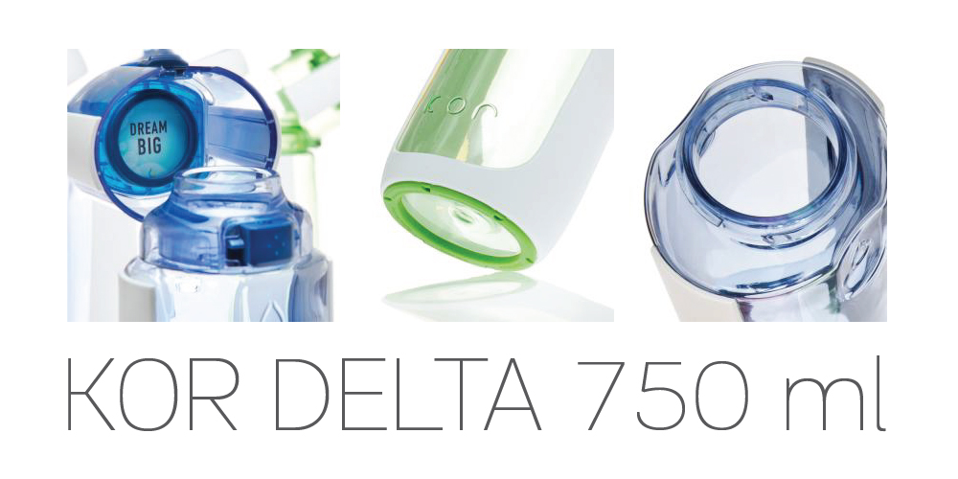
Easy to use
Notes:
Use the KOR DELTA water bottle and you will always have clean, slightly-mineralized, tasty and healthy water with you
at work
at home
on the go
while working out
while travelling

Slide 15

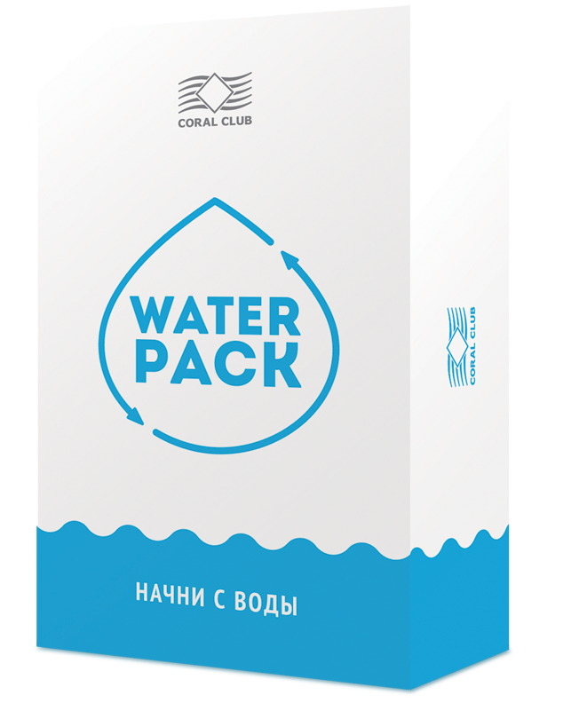
Other ideas
Notes:
Other ways you can use the Water Pack:
Give it as a gift
Use it to get noticed
Attract new club members
Use it and be healthy

Slide 16

Ваша здоровая, наполненная энергией
жизнь начинается с Water Pack
Notes:
Your healthy and full of energy life starts with the Water Pack!

