Slide 1
The best for mother and baby!
Prenatal +
A balanced vitamin-mineral complex for pregnant and feeding mothers.
CORAL-CLUB.COM

Slide 2



Pregnant and feeding mothers need an increased amount of nutrients.
That goes for women who are planning a pregnancy. Certain vitamins play an important role during conception and at the various stages of pregnancy.
Notes:
During pregnancy and breastfeeding, the need for nutrients (vitamins, minerals, PUFA and other nutrients) increases, because they are used not only on maintaining the health of the mother, but also on the development of the child. For example, the daily dose of folic acid (vitamin B9) during pregnancy increases almost 2 times!
Additional intake of vitamins is also important for those who are planning a pregnancy as well: the body needs to be prepared in advance for conception and the pregnancy term.

Slide 3

A lack of essential nutrients can have serious consequences for the mother and for the child.
Notes:
If, before pregnancy, a woman experienced even a small vitamin deficiency, after conception it can easily develop into a pronounced hypovitaminosis. Typical symptoms: deterioration of the skin, nails and hair, fatigue and apathy.
A lack of vitamins during pregnancy itself causes damage to the health of the mother and child. In the first trimester, a lack of vitamins and trace elements can cause fetal development anomalies and even a miscarriage. In the 2nd and 3rd trimesters, a deficiency of vitamins often leads to disruption in the formation of organs and causes problems in the work of the cardiovascular, nervous, endocrine and digestive systems in the fetus.
Deficiency of Omega 3 in the mother's body can negatively affect the baby's eye sight.
Most commonly, future mothers experience a deficiency in vitamins B6 (100%), B1 (96%), folic acid (77%) and vitamin C (64%). 70-80% of women, experience a deficit of three or more vitamins.
When lactating, vitamins and other nutrients are actively used in the formation of breast milk, so the mother often suffers from hypovitaminosis.

Slide 4

Pregnant women, trying to receive the necessary nutrients, often eat for 2.
This leads to overeating and a more than normal increase in weight.
At the same time, the problem of nutrient deficiency often remains.
Notes:
Pregnant women are often advised to eat more, but has been proven that "eating for two" does not double the chances of a healthy child. It does lead to a significant weight gain, which increases the risk of complications during pregnancy and childbirth.
This especially applies to the first trimester: if a woman has a healthy weight, then during this period she does not need any additional calories "for the child". But she needs an increased amount of vitamins!

Slide 5


The reason is simple: the nutritional value of modern food products is often questionable.
Notes:
It is well known that food these days is often poor in vitamins and minerals and is "rich" with harmful substances, which are especially undesirable during pregnancy.
To fill the daily norm of PUFAs, you need to eat quality fish every day, which can be difficult to find on store shelves.
Fruits and vegetables from the supermarket look beautiful, but from the point of view of vitamin value they are not attractive at all; In addition, many of them contain pesticides and nitrates, which are part of nitrogenous fertilizers. They are also treated to prolong shelf life.
Vegetables and fruits from farmer's markets are the best choice, but their nutritional value depends on the quality of the soil and the growing conditions.

Slide 6



Often pregnant women develop an intolerance to certain foods, which can be a problem if that food has important nutritional value. For example, fish or meat.
Notes:
Another reason for a pregnant woman not to receive the necessary vitamins and minerals is intolerance of certain foods or allergies to them. For example, if, due to lactose intolerance, a pregnant woman excludes dairy products from her diet, a marked deficiency of calcium and vitamin D can occur.
In addition, during this period, a woman’s sense of taste and smell can change dramatically. Many women suddenly stop eating fish or other foods that they gladly consumed before pregnancy.
Vegetarians have a high risk of missing out on valuable substances, which are contained in products of animal origin.
Finally, women, accustomed to unhealthy eating, can not abruptly adjust to proper nutrition during pregnancy and continue to eat in their usual fashion.

Slide 7
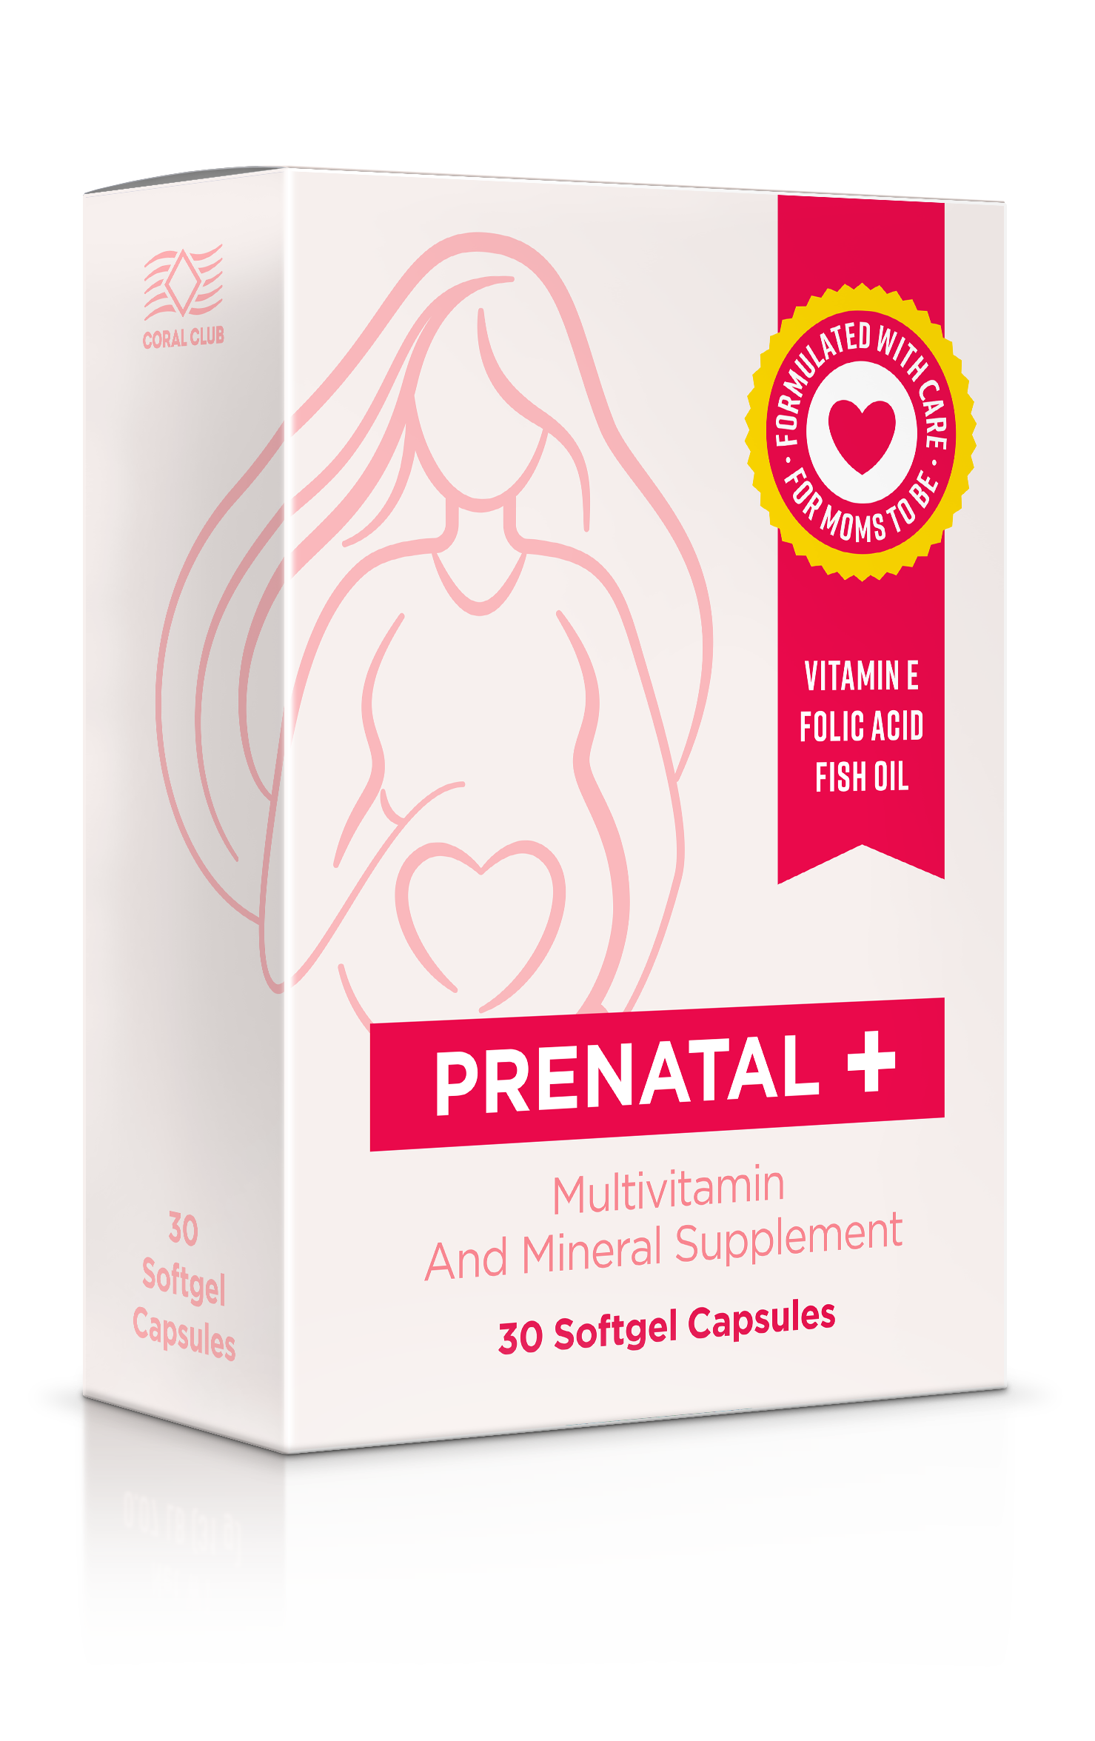
Prental + a vitamin-mineral complex
Prental + a turn-key solution for a common problem!
♥ Provides vital nutrients during pregnancy and breastfeeding
♥ Helps to ensure proper development of the fetus
♥ Helps to avoid some common health issues that pregnant women experience, because of nutrient deficiency
30 capsules = 1 month supply

Slide 8
Prenatal +
The best for mother and baby!
Notes:
Prenatal + contains all the vitamins, minerals and PUFAs that are most necessary during pregnancy, in the optimal amount and concentration. This product supports the woman at a time when it is especially important, and helps her to safely go through the pregnancy and give birth to a healthy child!

Slide 9

EVERYTHING YOU NEED IN 1 CAPSULE
Omega 3 (DHA 200 mg)
D3, E, B1, B2, B3, B5, B6,
B7 (Biotin), В9 (Folate), В12
Iodine, selenium, zinc
Notes:
1 capsule once a day - it's more convenient and easier than taking separate supplements of fish oil and several vitamin capsules or tablets

Slide 10
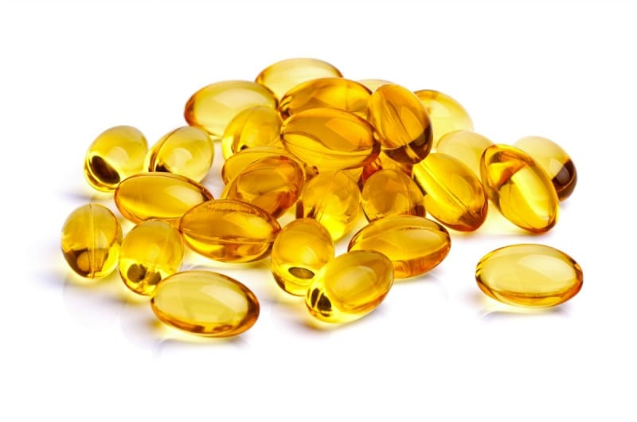
Omega 3 (DHA)
Prenatal + contains fish oil – a source of Omega 3.
DHA is a polyunsaturated fatty acid, essential for the health of virtually all organs and systems of the body.
Notes:
In the product Prenatal +, fish oil is present in the form of docosahexaenoic acid (DHA) - the most beneficial type of Omega 3
An insufficient amount of DHA in the body of a pregnant woman can increase the risk of premature birth.
DHA is necessary for the healthy development of the fetus and the health of the child in the first years of life: studies show that children who receive high amounts of DGA in utero have better vision. DHA is also important for brain of the fetus, which begins to develop already in the first weeks of pregnancy.
DHA is also useful for infants - five-year-old children who received DHA with breast milk in the first 4 months of life showed better attention and increased capacity for concentration.
DHA supports the health of the heart and blood vessels, helping to strengthen the walls of blood vessels and capillaries, to normalize the work of the heart, to lower the level of "bad" cholesterol.

Slide 11


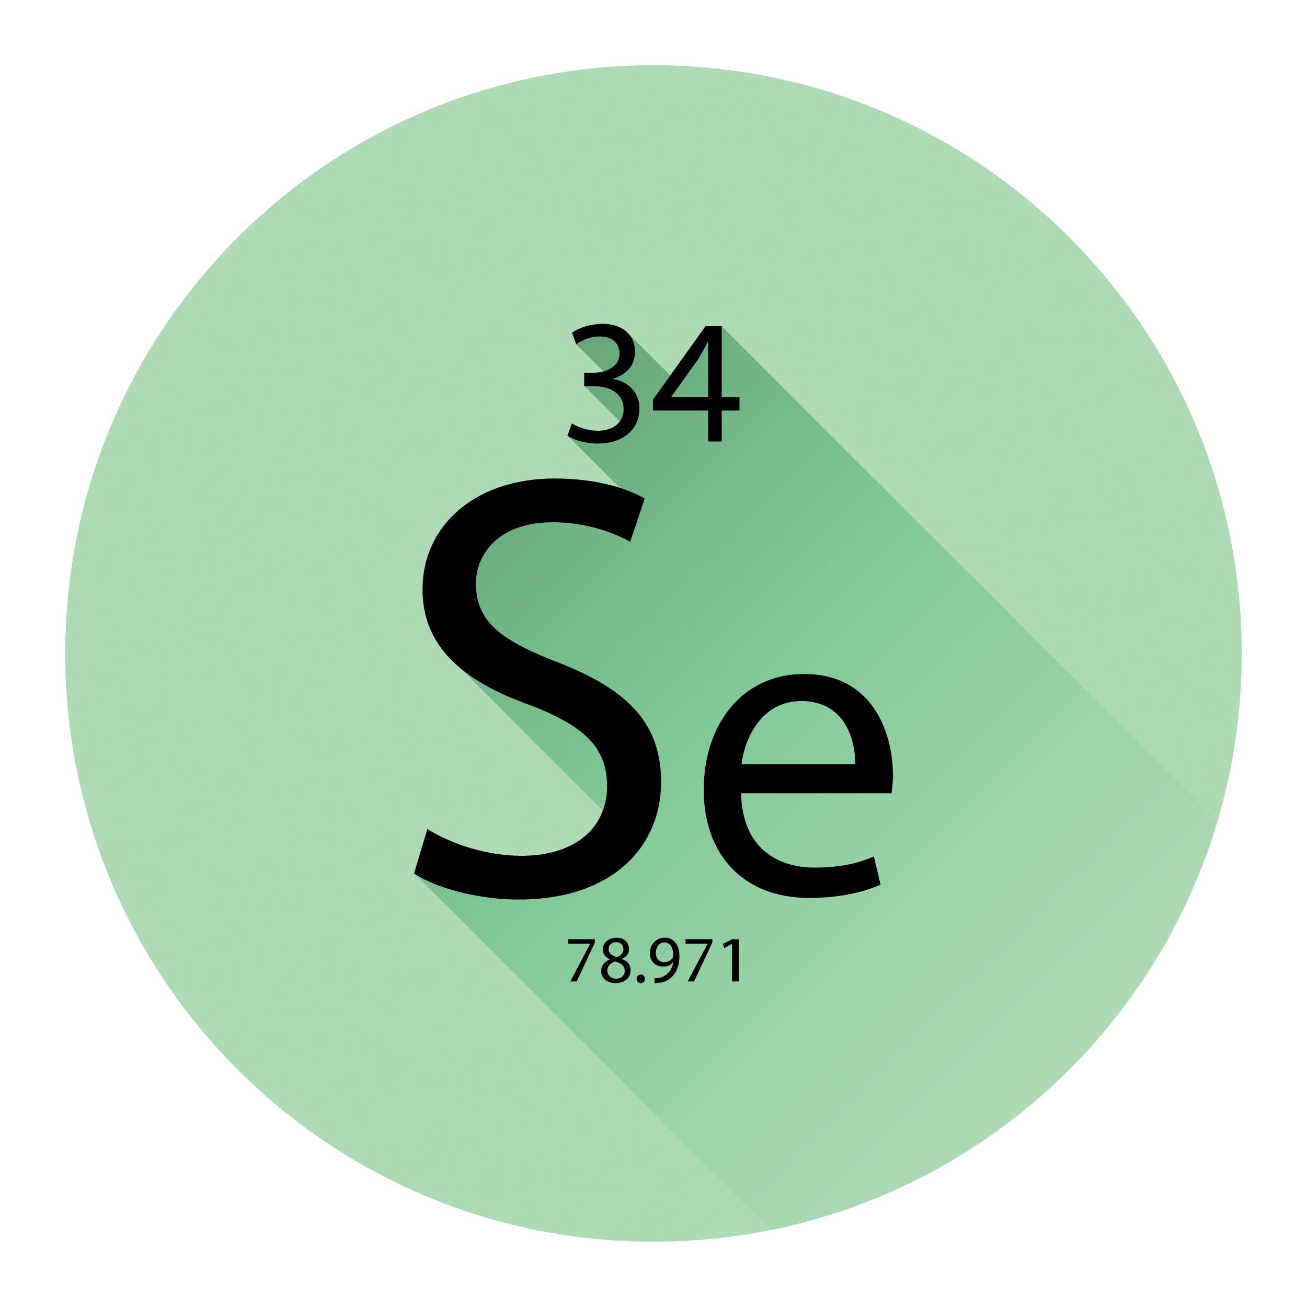
A mineral complex
Prenatal + contains some of the most important minerals for health
zinc, selenium and iodine
Notes:
A serious lack of selenium in the body of a pregnant woman can lead to giving birth to a child with congenital anomalies. Such newborns may suffer from muscle weakness, underdevelopment of the spine, heart defects, diseases of the respiratory system, nervous and mental disorders. Deficiency of selenium can also lead to late toxicosis and premature birth. The probability of vascular and muscular hypertension, edema, anemia and depressive states increases.
Chronic zinc deficiency during pregnancy can lead to complications during childbirth (lengthening of labor, postpartum bleeding, development of congenital anomalies in a child, impaired infant health).Zinc, like selenium, supports immunity and increases the body's resistance to infections (which is especially important during pregnancy, when it is necessary to be very cautious of taking medication).
Iodine is important for the normal functioning of the thyroid gland. Insufficient intake of this element during pregnancy can lead to the formation of a goiter and subsequent changes in thyroid function. Receiving enough iodine helps to prevent the occurrence of thyroid disorders in the child. The presence of iodine in the body is an indispensable condition for the development of thyroid hormones, which play an important role in the formation of the brain during the period of intrauterine development.

Slide 12
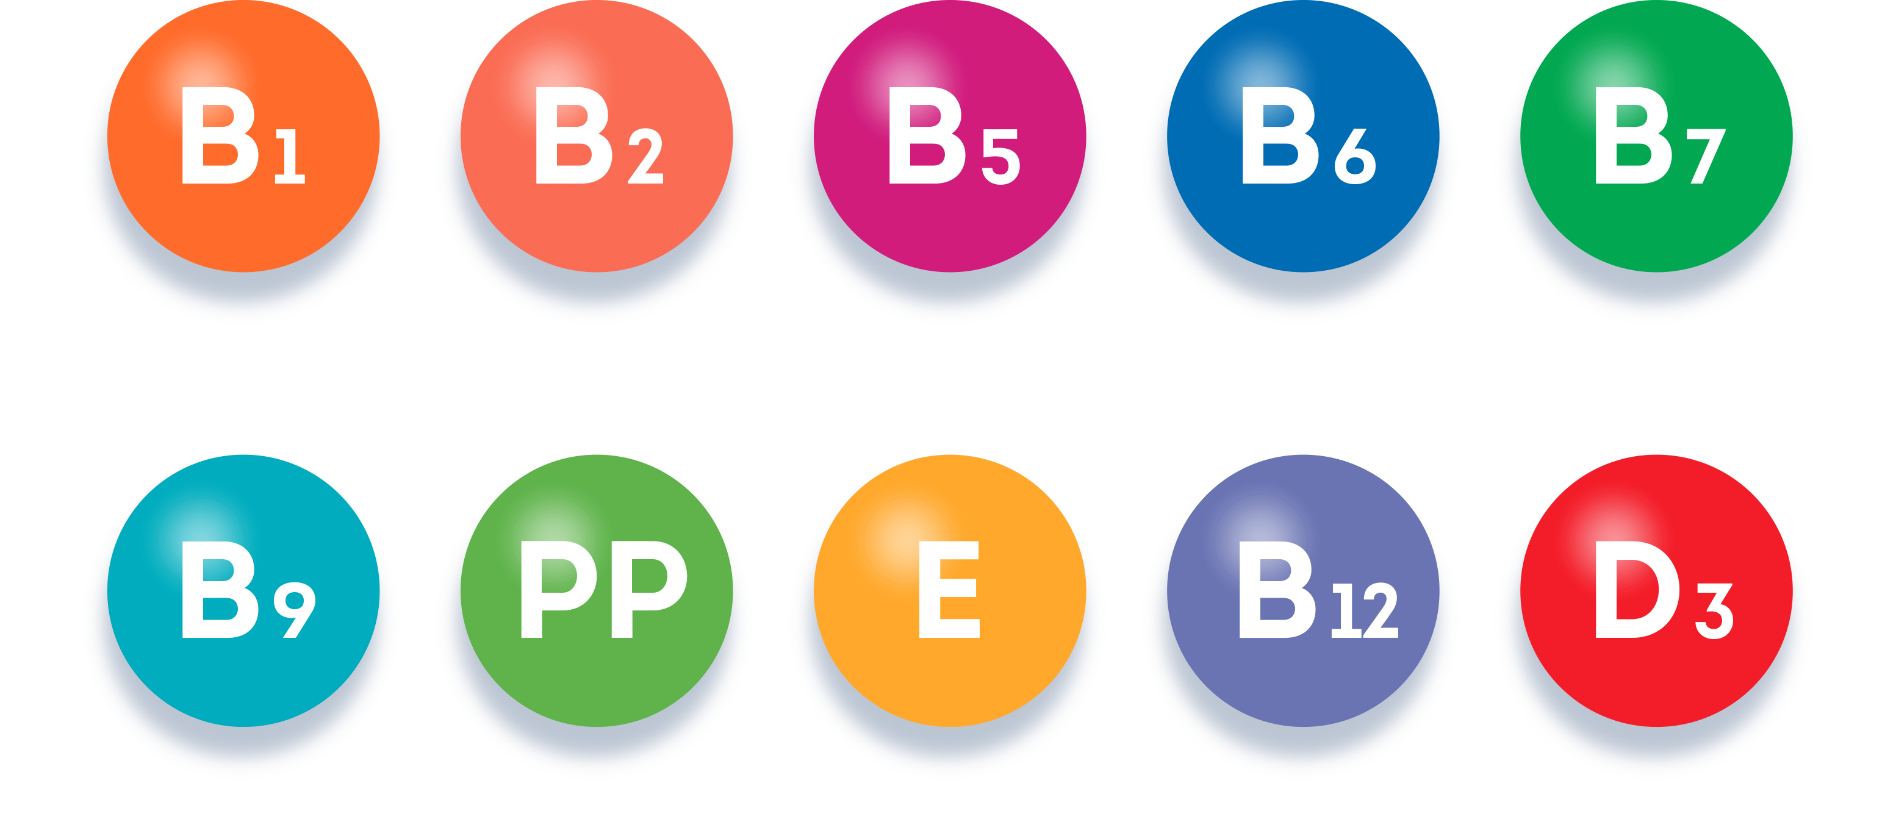
A vitamin complex
Prental + contains all the essential vitamins for a pregnant woman.
Notes:
Prenatal + contains the most important vitamins for pregnant women.
B vitamins help to ensure normal functioning of the nervous system, are responsible for energy metabolism, increase resistance to stress. Deficiency of vitamins of this group can adversely affect the health of the mother and the development of the nervous system of the fetus.
Folic acid (vitamin B9) and vitamin B12 are two important vitamins in this group.
Folic acid plays an important role in the biosynthesis of amino acids and nucleic acids, and therefore - in cell division. The need for folic acid is especially increased with frequent pregnancies and with multiple pregnancies. А deficiency of folic acid in pregnant women is associated with a defect of the neural tube - a dangerous defect for the development of the fetus, which often leads to the death of the fetus or disability in the child.
Vitamin B12 is important for the normal formation of the fetal nervous system and for the prevention of nervous disorders in a pregnant woman. Deficiency of this vitamin in the diet of a pregnant woman can result in serious problems and even abnormalities in the development of the fetus - for example, underdevelopment of the nervous system.
Vitamin E is especially important in the first trimester. It is necessary for the normal development of the child and the functioning of the placenta.
Vitamin PP (niacin) is required for stable intrauterine development of the fetus and the normal course of pregnancy. It participates in the regulation of the thyroid gland and adrenal glands, the incorrect functioning of which, can increase the risk of abortion.
Vitamin D3 is involved in the regulation of mineral metabolism. Bone strength, good posture, and dental health largely depend on it. It is especially important to take it during pregnancy - for better absorption of calcium. The intake of vitamin D positively affects the state of the immune system. It is also necessary for the normal functioning of the thyroid gland and coagulability of the blood.

Slide 13

Carob – a natural coloring agent
PRENATAL + does not contain harmful or unfavorable components
Titanium dioxide, artificial coloring or flavoring agents
Notes:
Prenatal + does not contain harmful or unfavorable excipients - iron salts and titanium dioxide, which are often used as coloring agents.
We used a natural dye carob, obtained from locust beans. ? Carob is a dietary alternative to chocolate, however it does not contain caffeine and theobromine.
All only the most useful and safe!

Slide 14

Everything essential combined
Omega 3, vitamins and minerals all together in 1 complex
Convenience
1 capsule once per day
Balance
Components that work well together
Optimal dosage
Recommended amounts for pregnant women
4 reasons to choose Prenatal +
Notes:
Prenatal + is convenient to take.
1 capsule is convenient: you do not need to carry the whole package with you, and you're less likely to forget to take it.
Prenatal + increases the likelihood of a healthy pregnancy, helps to reduce the risk of complications and congenital anomalies, contributes to the normal development of the fetus.
Prenatal + supplies the body with everything you need (PUFAs Omega 3, vitamins and minerals) and helps to eliminate the effects of an unbalanced nutrition during pregnancy or breastfeeding. It is also recommended for those who plan pregnancy - for the prevention of hypovitaminosis.

Slide 15
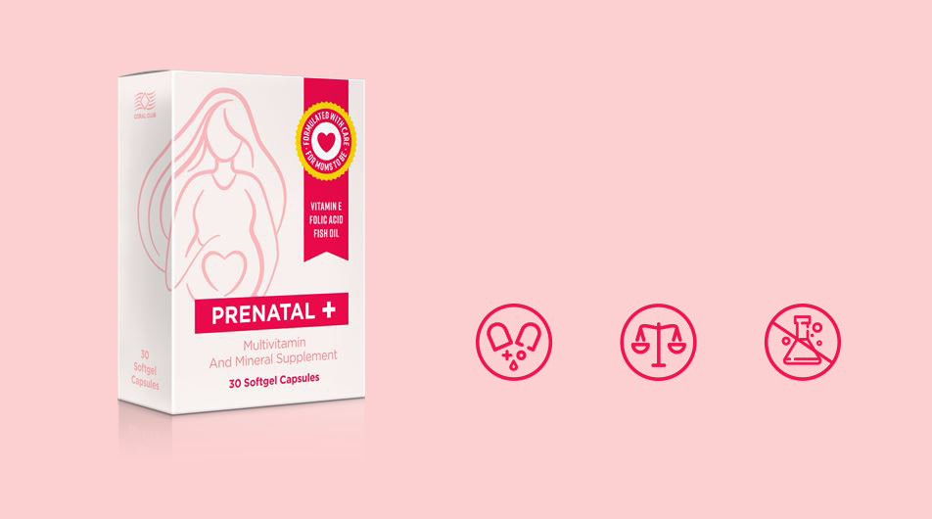
PRENATAL +
The best for mother and baby – in 1 capsule.
Everything you need in 1 capsule
Optimal dosage
Nothing extra
Notes:
Everything you need in 1 capsule
Optimal dosage
Nothing extra

